Slide 1

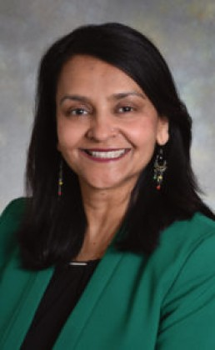
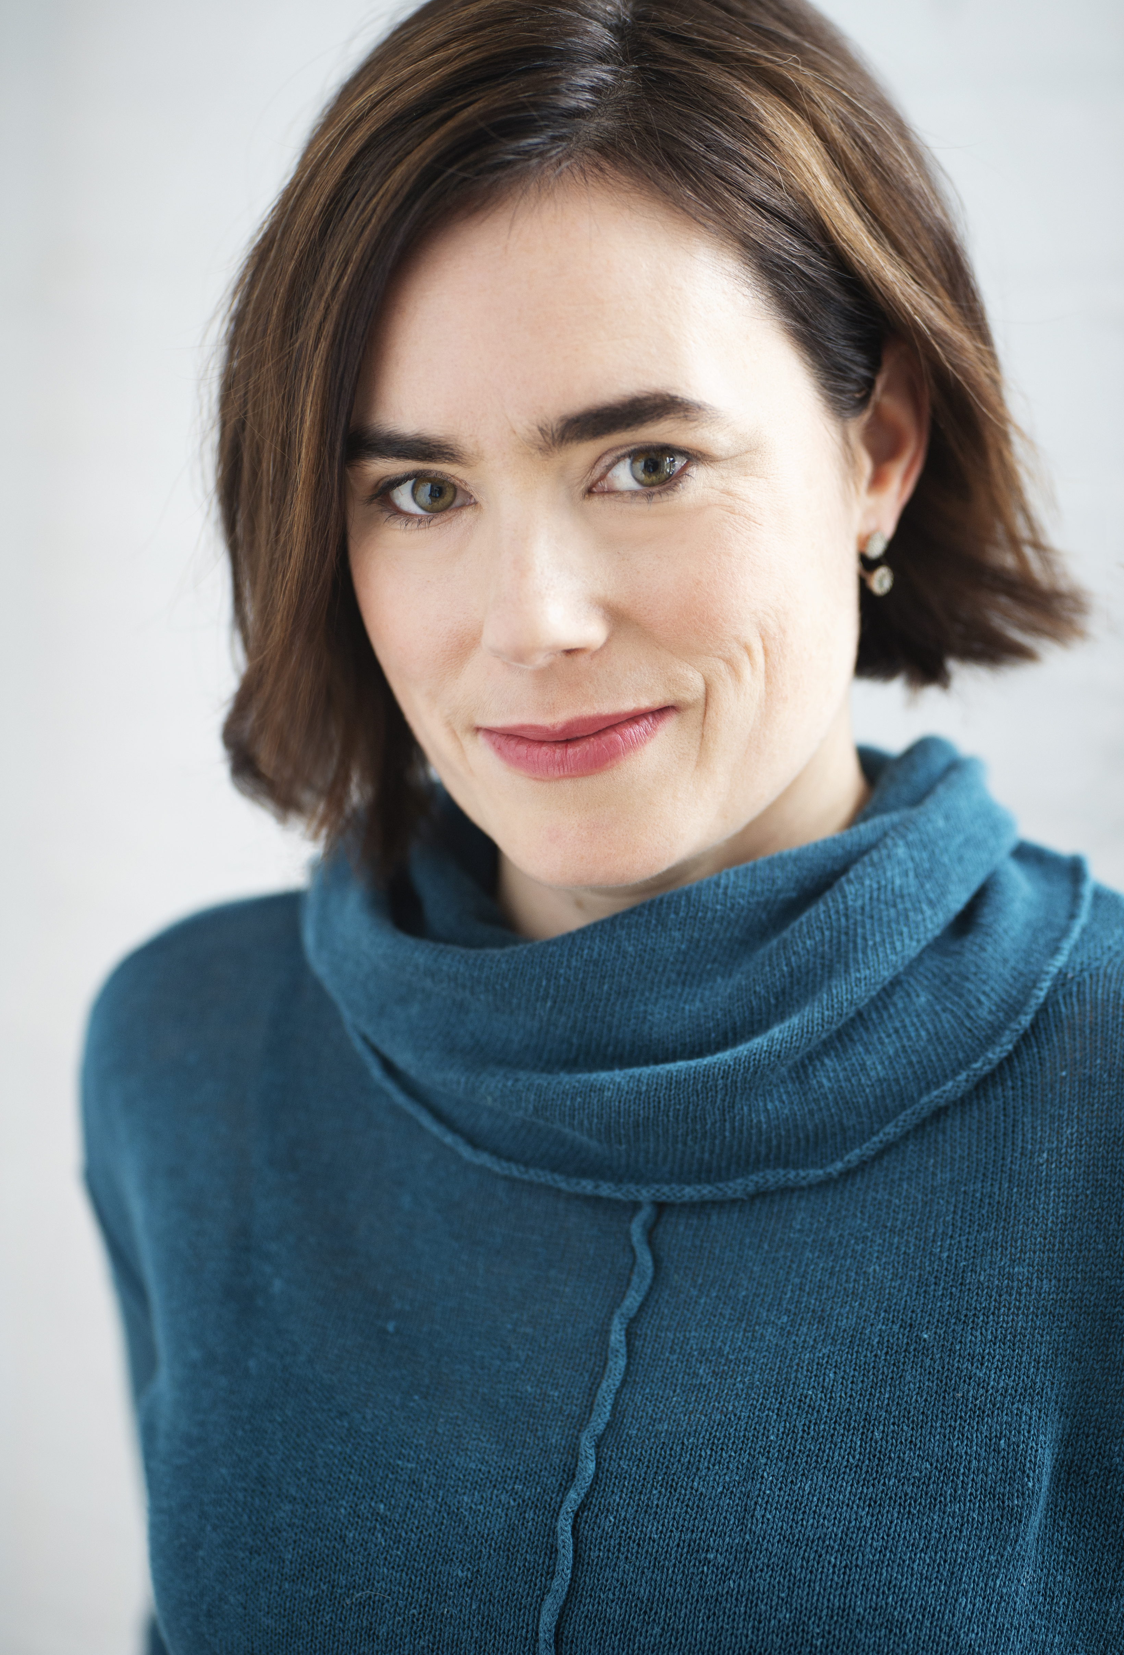
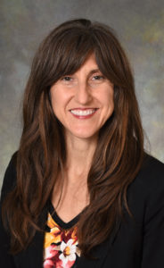
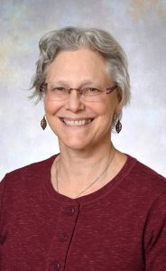
Planning and Implementing Integrative Health Project ECHO
(Extension For Community Healthcare Outcomes)
Programs
Arti Prasad, MD, FACP, CPE, CPDC
Catherine Justice, DPT, C-IAYT
Kate Shafto, MD
Susan Haddow, MD
Division of Integrative Health and Wellness
Notes:
Dr. Prasad to present – quick intro for each team member
What our training and certifications are
Name our bias – we are all ECHO devotees!

Slide 2
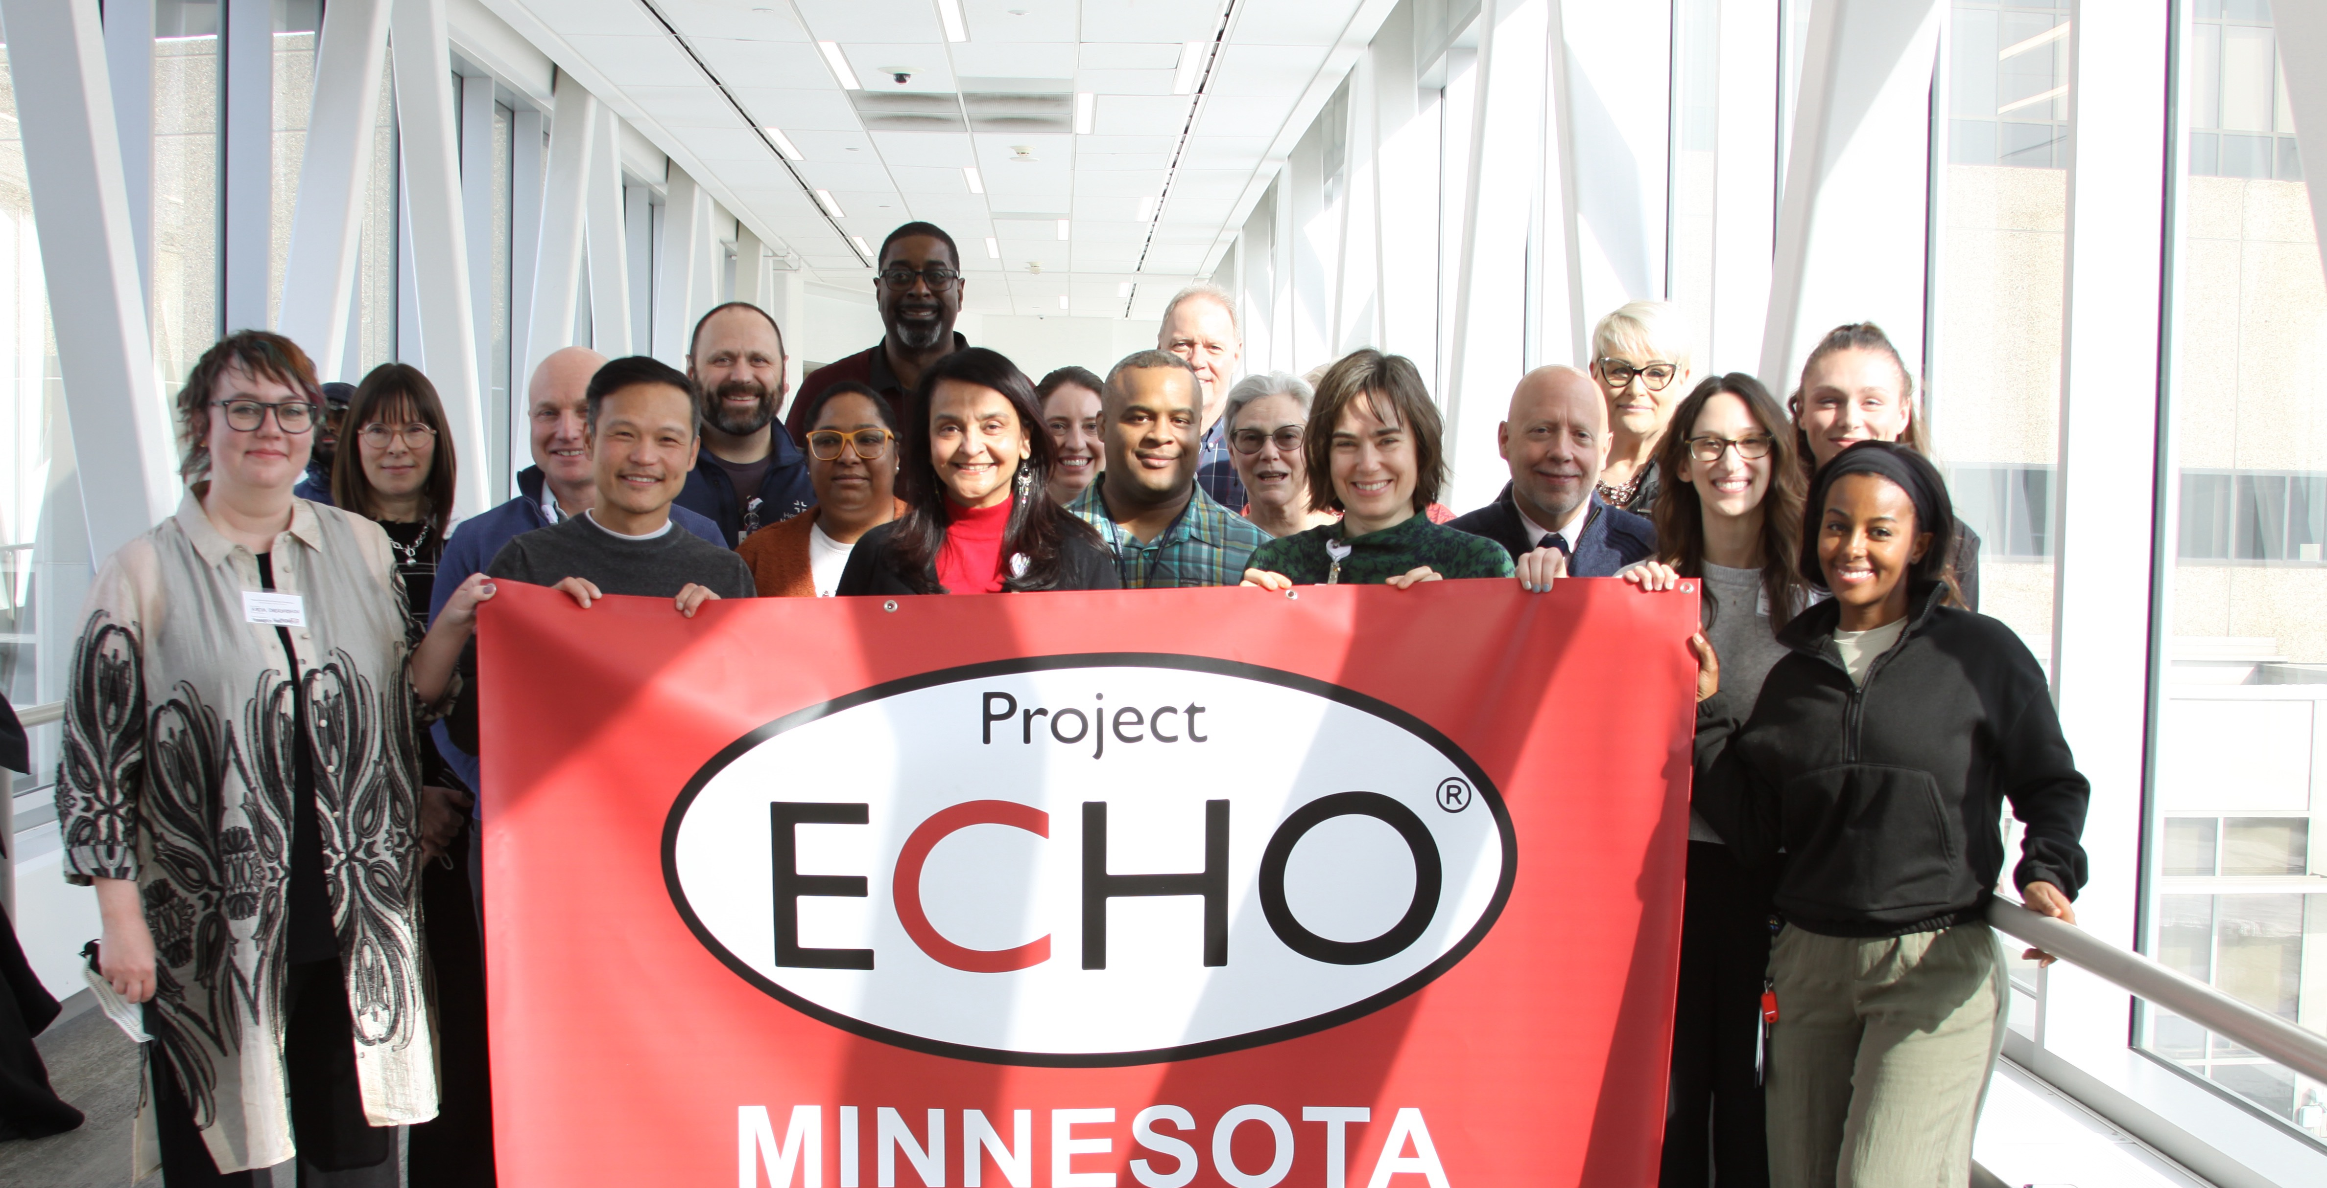
ACKNOWLEDGEMENT
Notes:
Arti

Slide 3

Centering – Quick Coherence
Use the power of your heart to balance thoughts and emotions to achieve energy and mental clarity.
Helps reduce stress in the moment.
Feel positive, focused, calm and energized.
Perform at your best.
Access creativity, intuition and higher-level decision making.
Notes:
Sue

Slide 4


Transforming the Health of our Community – Exceptional Care without Exception
Our Mission
Notes:
Dr Prasad

Slide 5
Objectives
Understand the “All Teach, All Learn” Project ECHO Model ​
Explore how Project ECHO has the potential to increase access to Integrative Medicine in rural and other underserved areas and populations ​
Experientially and collaboratively plan the design and implementation of an Integrative Health-themed Project ECHO ​
Notes:
Dr Prasad

Slide 6

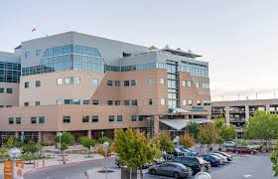
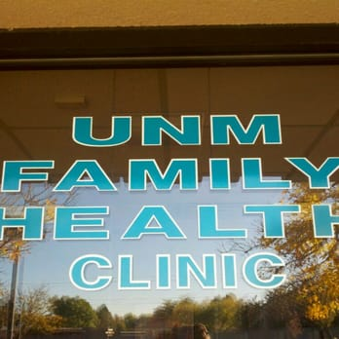
University of New Mexico
UNM Hospital (1990-2017)
Notes:
Dr Prasad

Slide 7
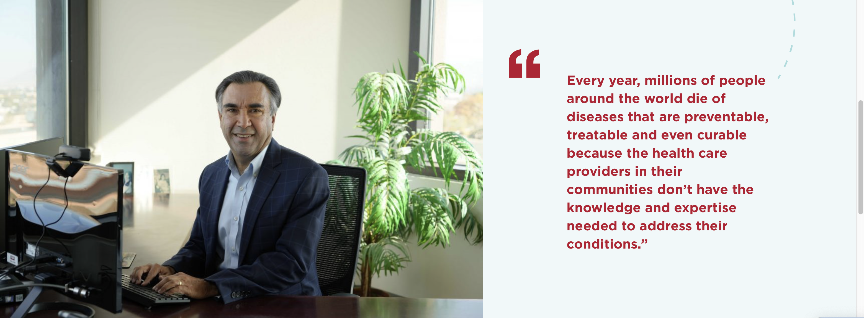
Dr. Sanjeev Arora, Founder and Director of Project ECHO
Founding goals:
Develop capacity to safely and effectively treat Hepatitis-C (HCV) in all areas of New Mexico and to monitor outcomes.
Develop a model to treat complex diseases in rural locations and developing countries.
Notes:
Dr Prasad

Slide 8
Moving Knowledge, Not People
Notes:
Dr Prasad

Slide 9
At ECHO, our mission is to democratize implementation of best practices for health care and education to underserved people all over the world.
Notes:
Dr Prasad

Slide 10
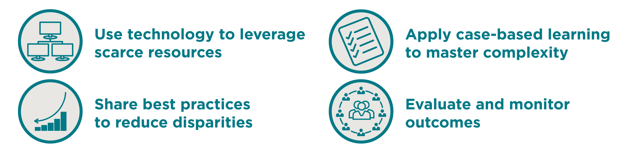
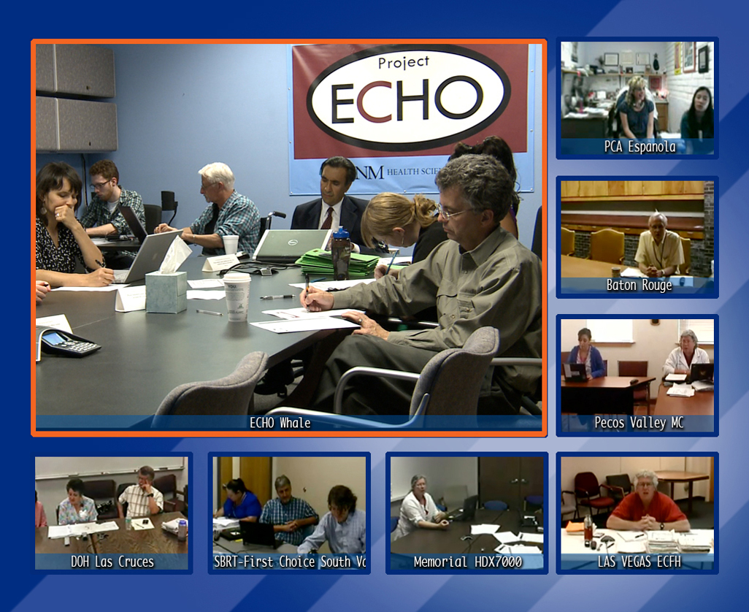

The ECHO Model
Copy Righted slides used with permission
Notes:
Dr Prasad

Slide 11
An ECHO Hub...
Trains physicians, physician assistants, nurse practitioners, nurses, pharmacists, educators in HCV
Trains to use web-based software — iECHO & ECHO Health®
Conducts ECHO sessions — “Knowledge Networks”
Initiates case-based guided practice — “Learning Loops”
Collects data and monitors outcomes centrally
Assesses cost and effectiveness of programs
Notes:
Dr Prasad
Learning Loops means they will learn from experts, from each other and then learning by doing to become expert themselves

Slide 12
Spoke
Spoke
Spoke
HCV was our flagship Program
HUB
Spoke
Spoke
Spoke
Spoke
Notes:
Dr Prasad

Slide 13
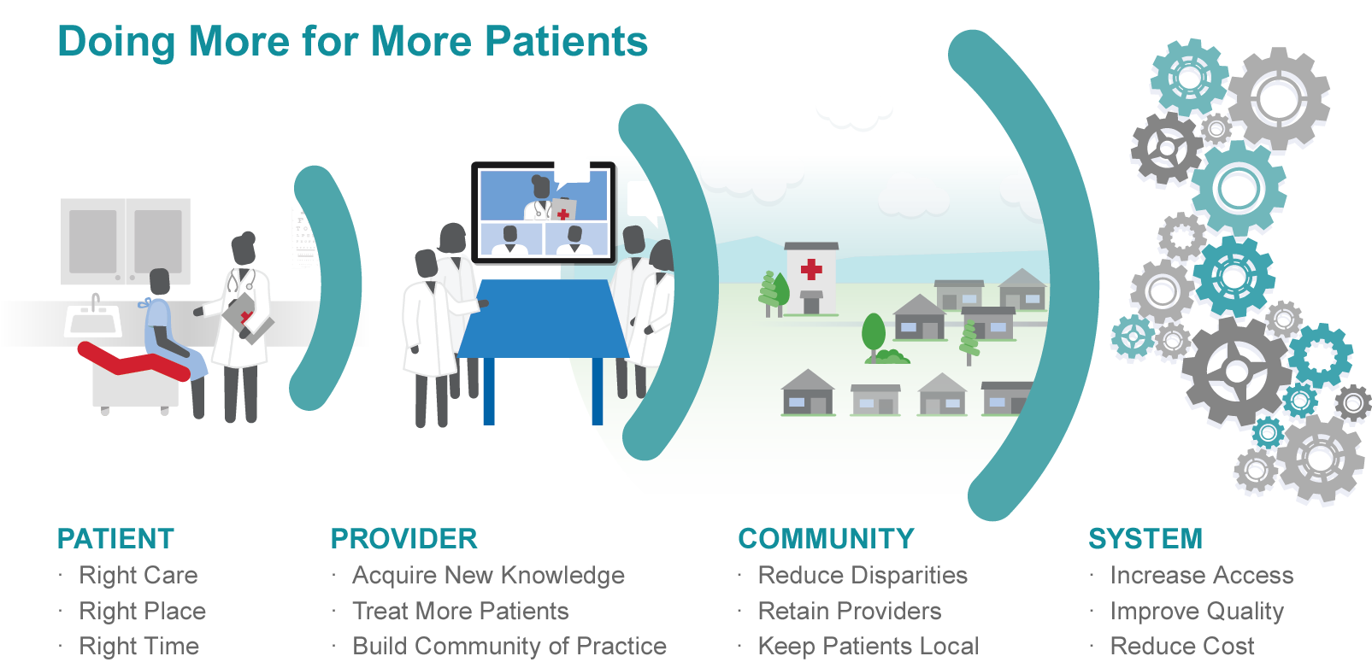
Benefits from Project ECHO
Notes:
Dr Prasad

Slide 14
ECHO creates VALUE for all parts of the healthcare system
Patients
Community
Community Clinics
Providers (spoke)
Providers (hub)
Payers
Rural Clinicians
It is very important to not simplify this to Return on Investment (ROI) equation, but rather as a VALUE EQUATION. ECHO may deliver ROI, but it has a much greater value impact on all segments of the health care system.
Notes:
Dr Prasad

Slide 15
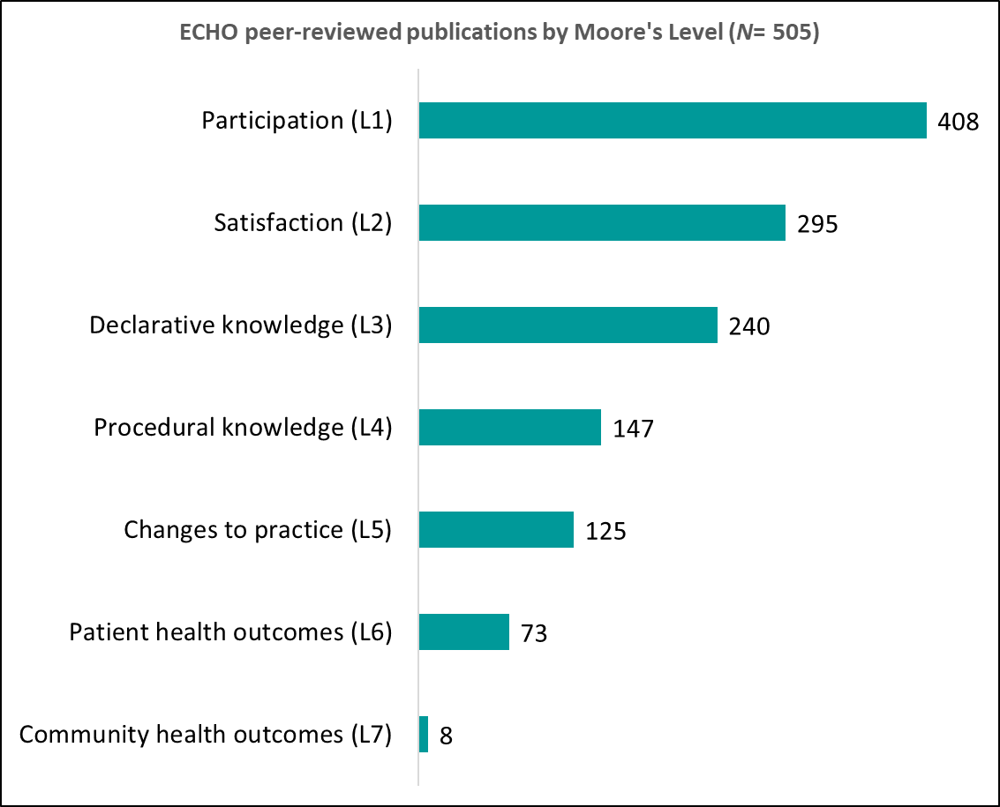
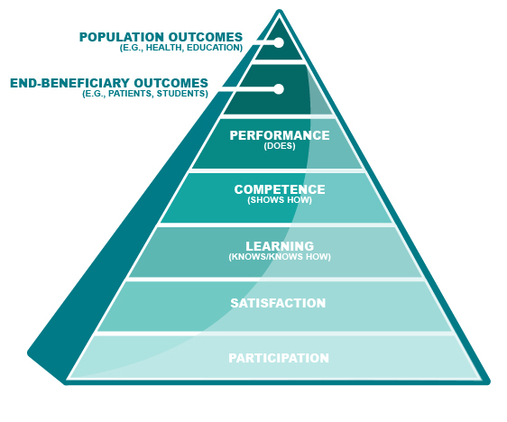
ECHO Publications by Outcome Levels
500+ Publications
Notes:
Dr Prasad

Slide 16
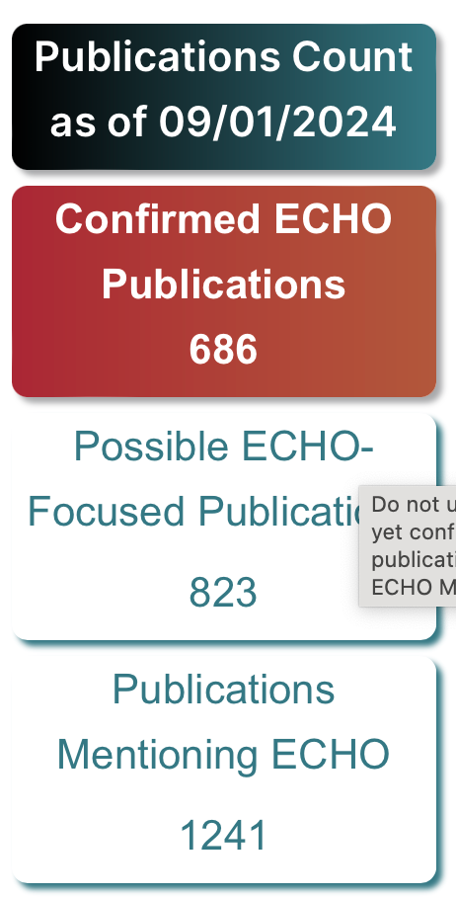
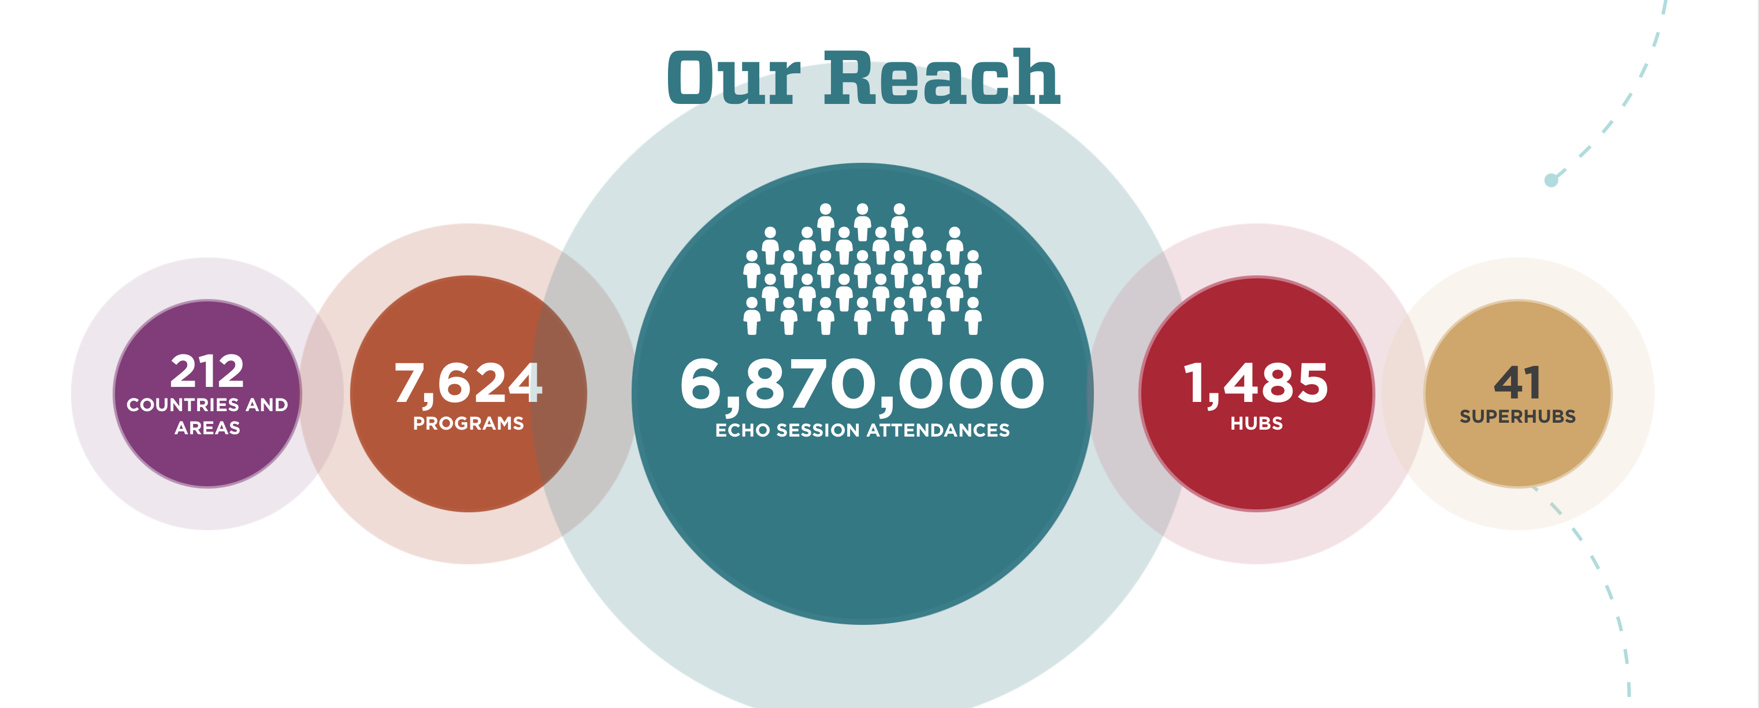
Notes:
Dr Prasad

Slide 17
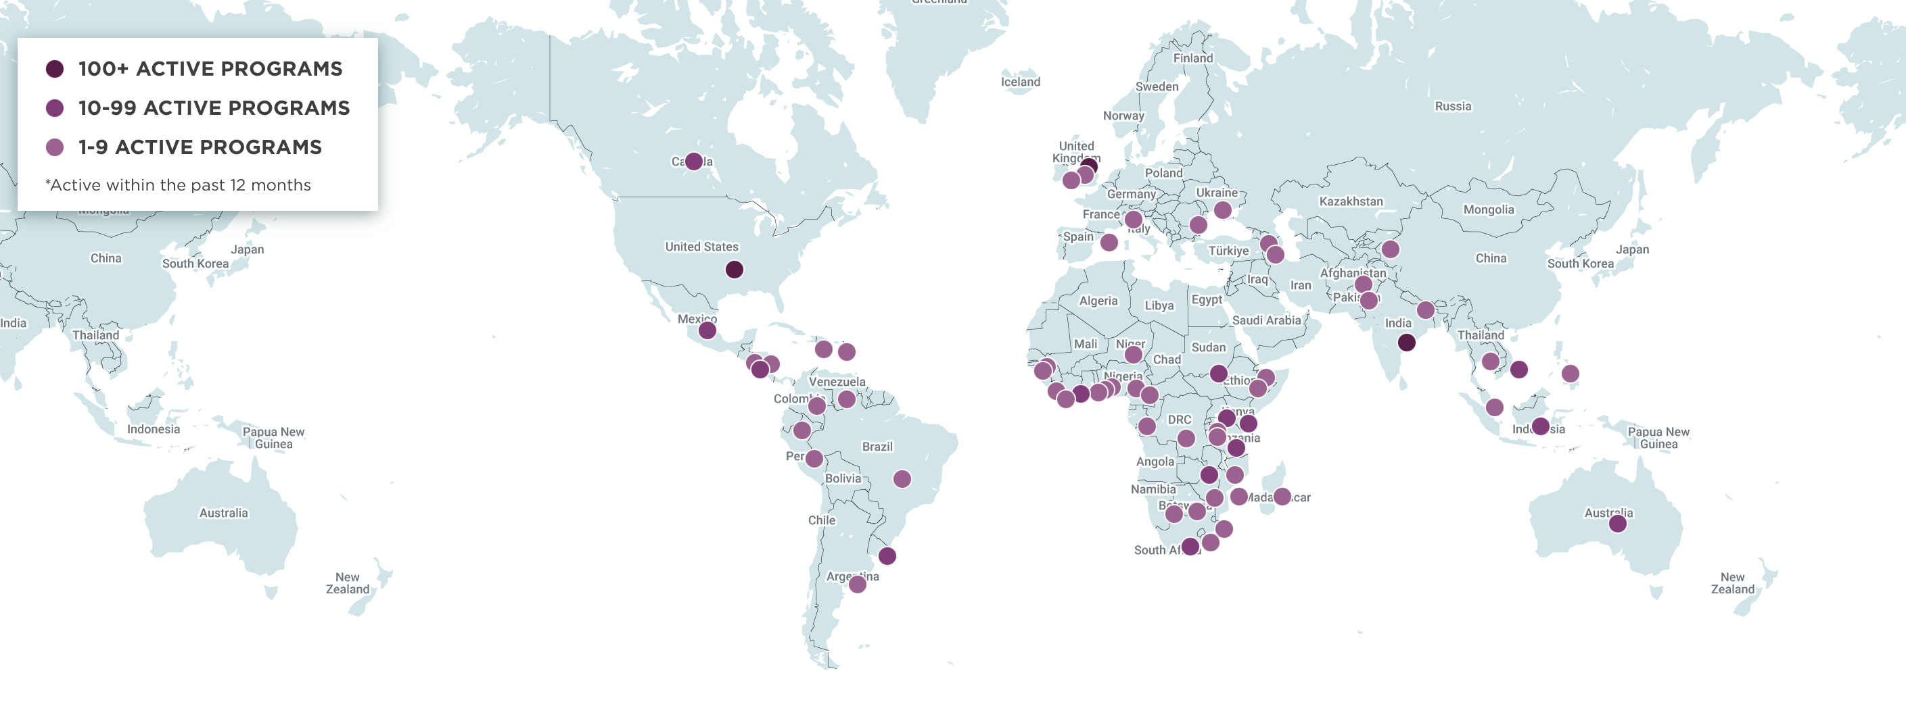
ECHO AROUND THE WORLD
Notes:
Dr Prasad

Slide 18


New Mexico to Minnesota
Notes:
Dr Prasad

Slide 19
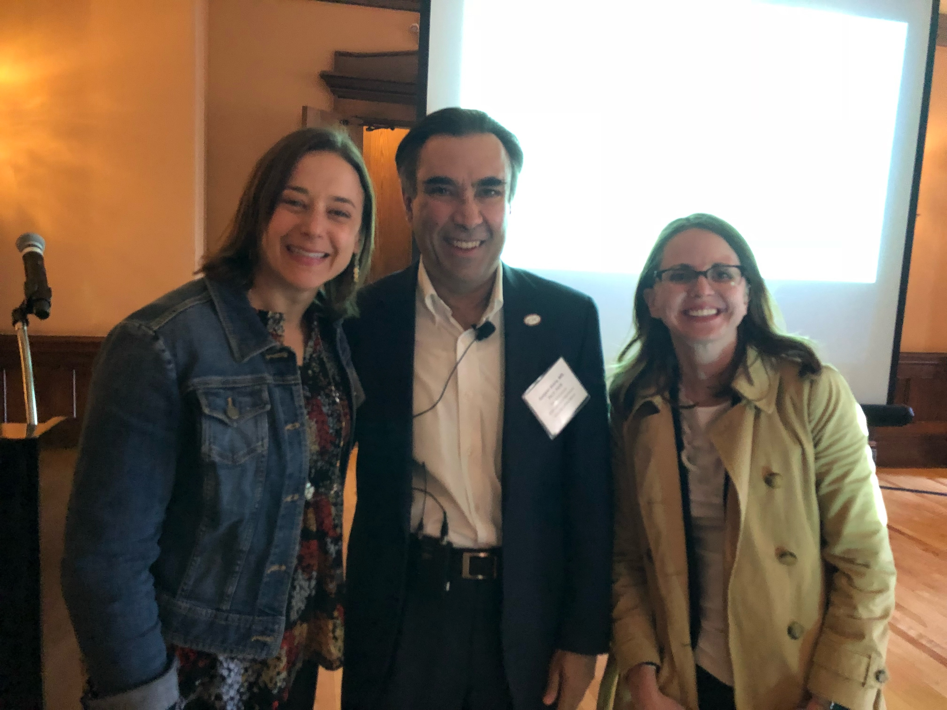
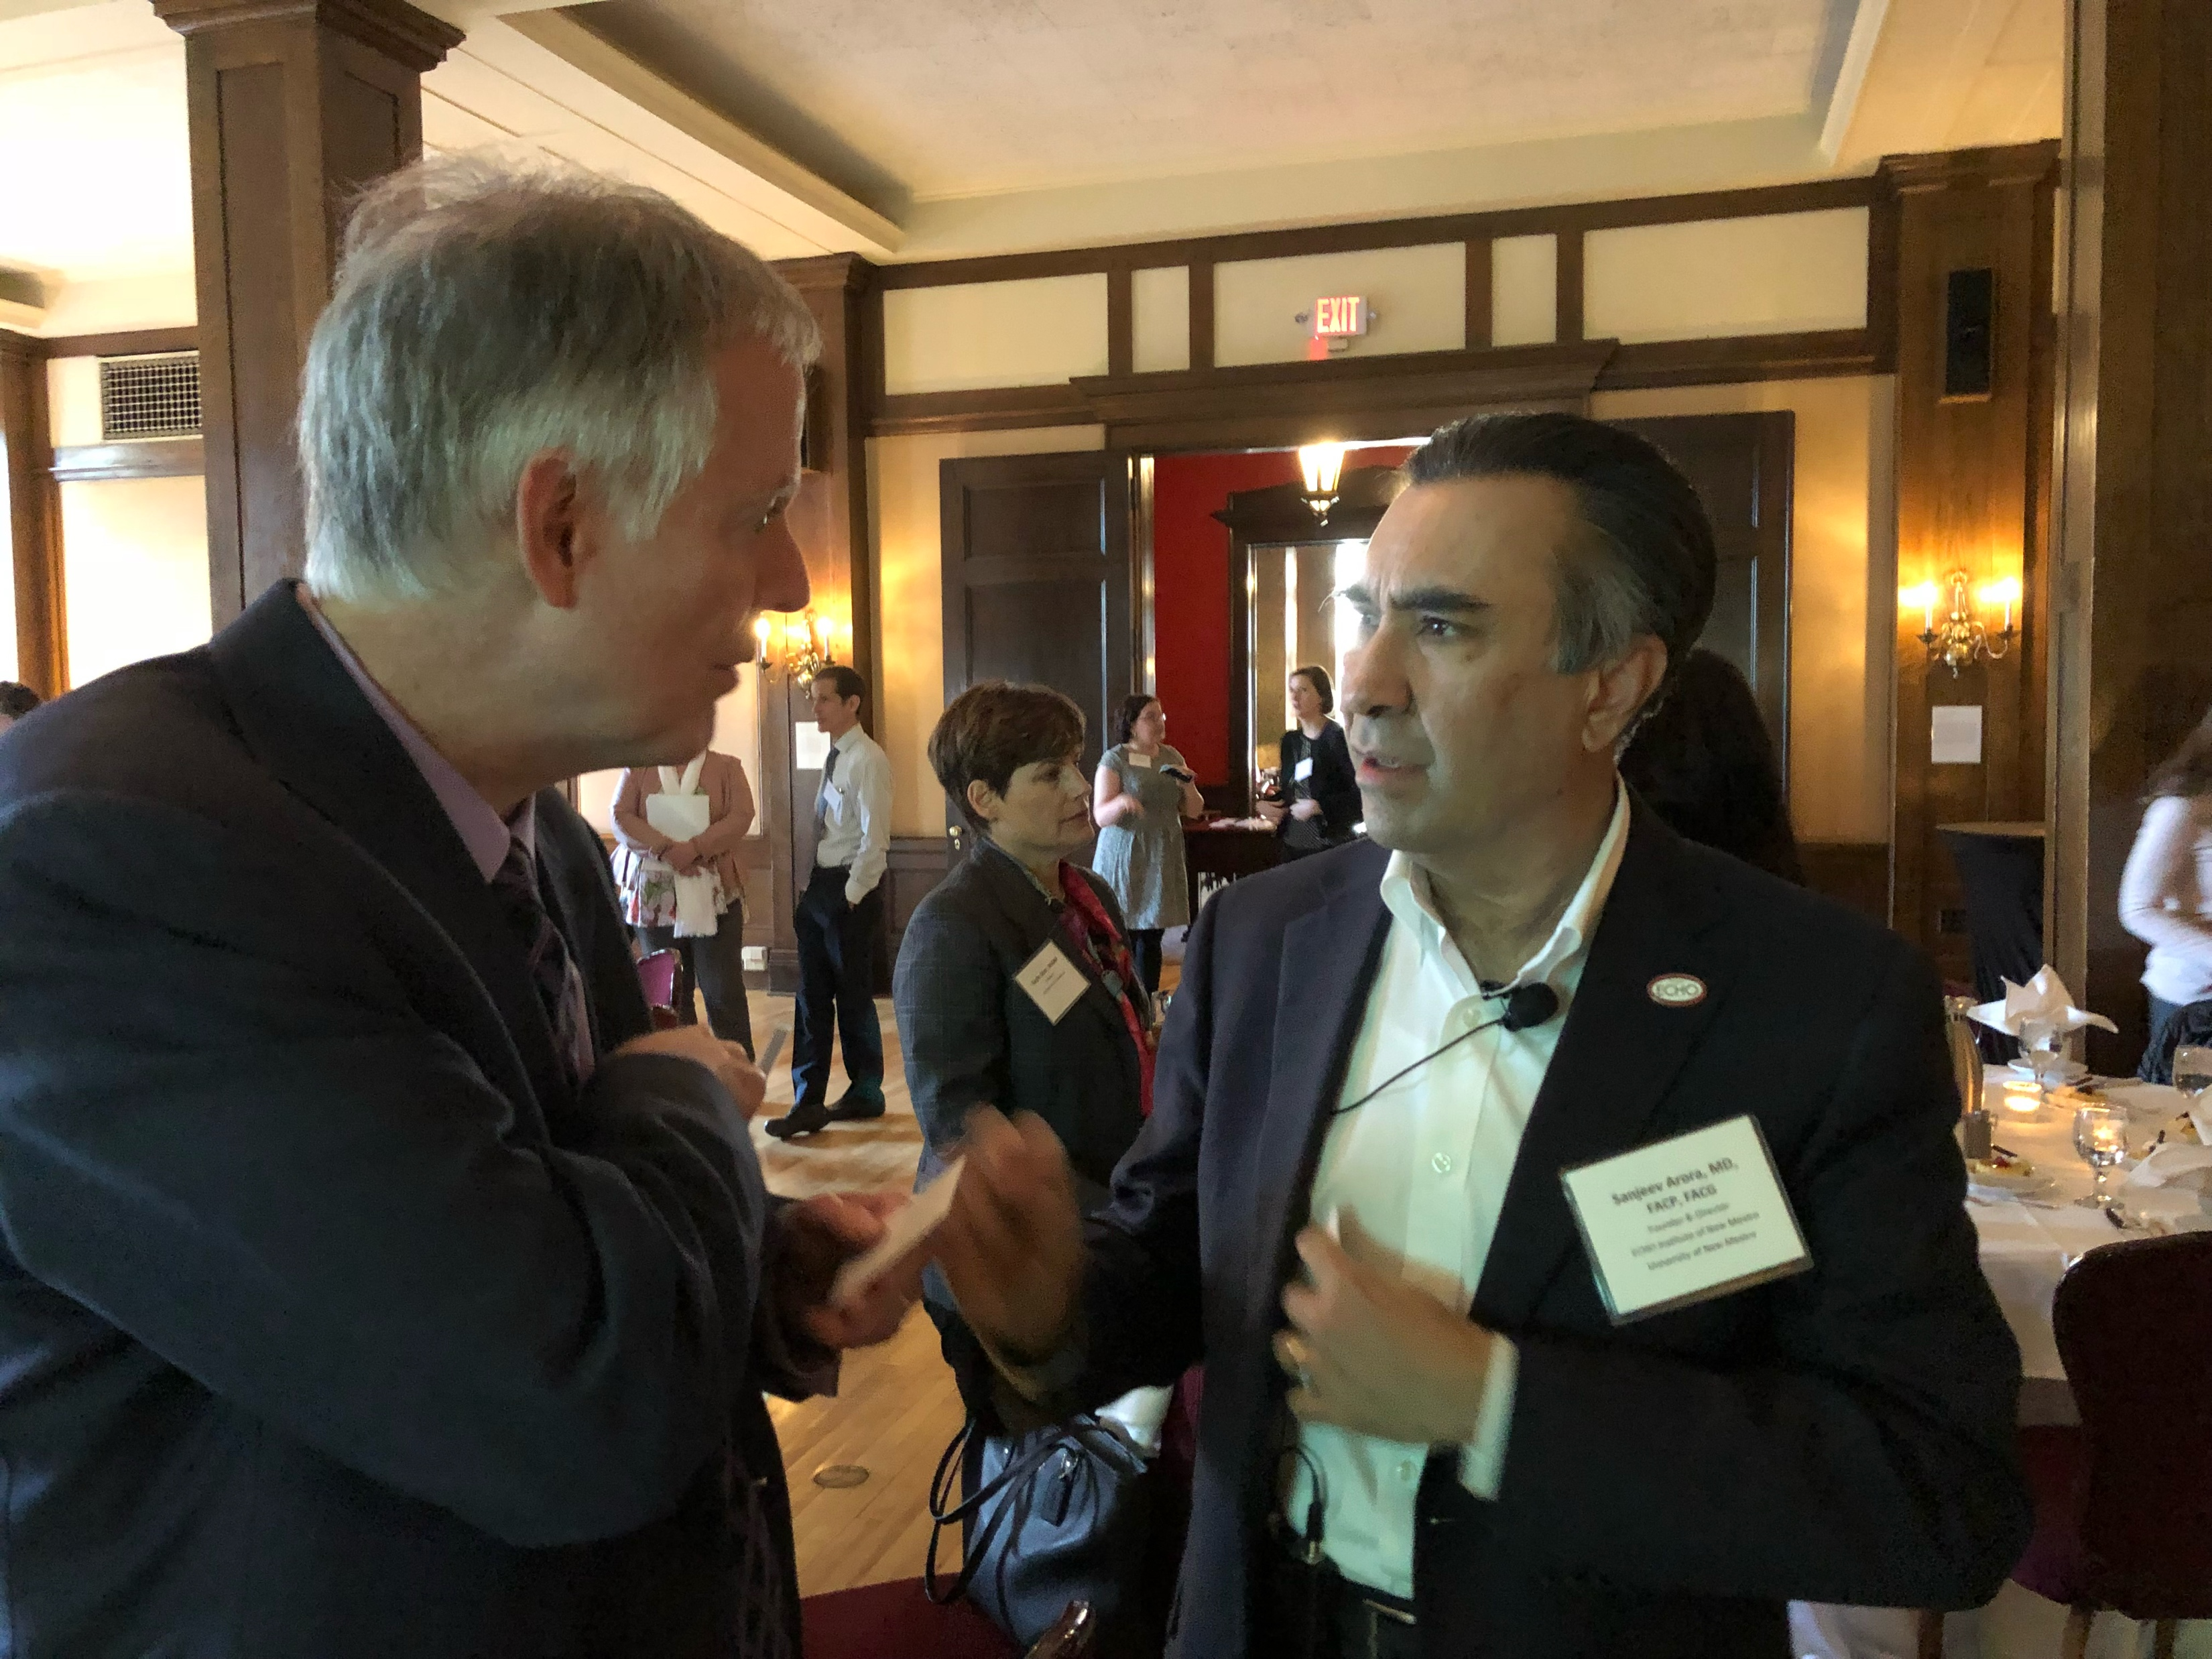
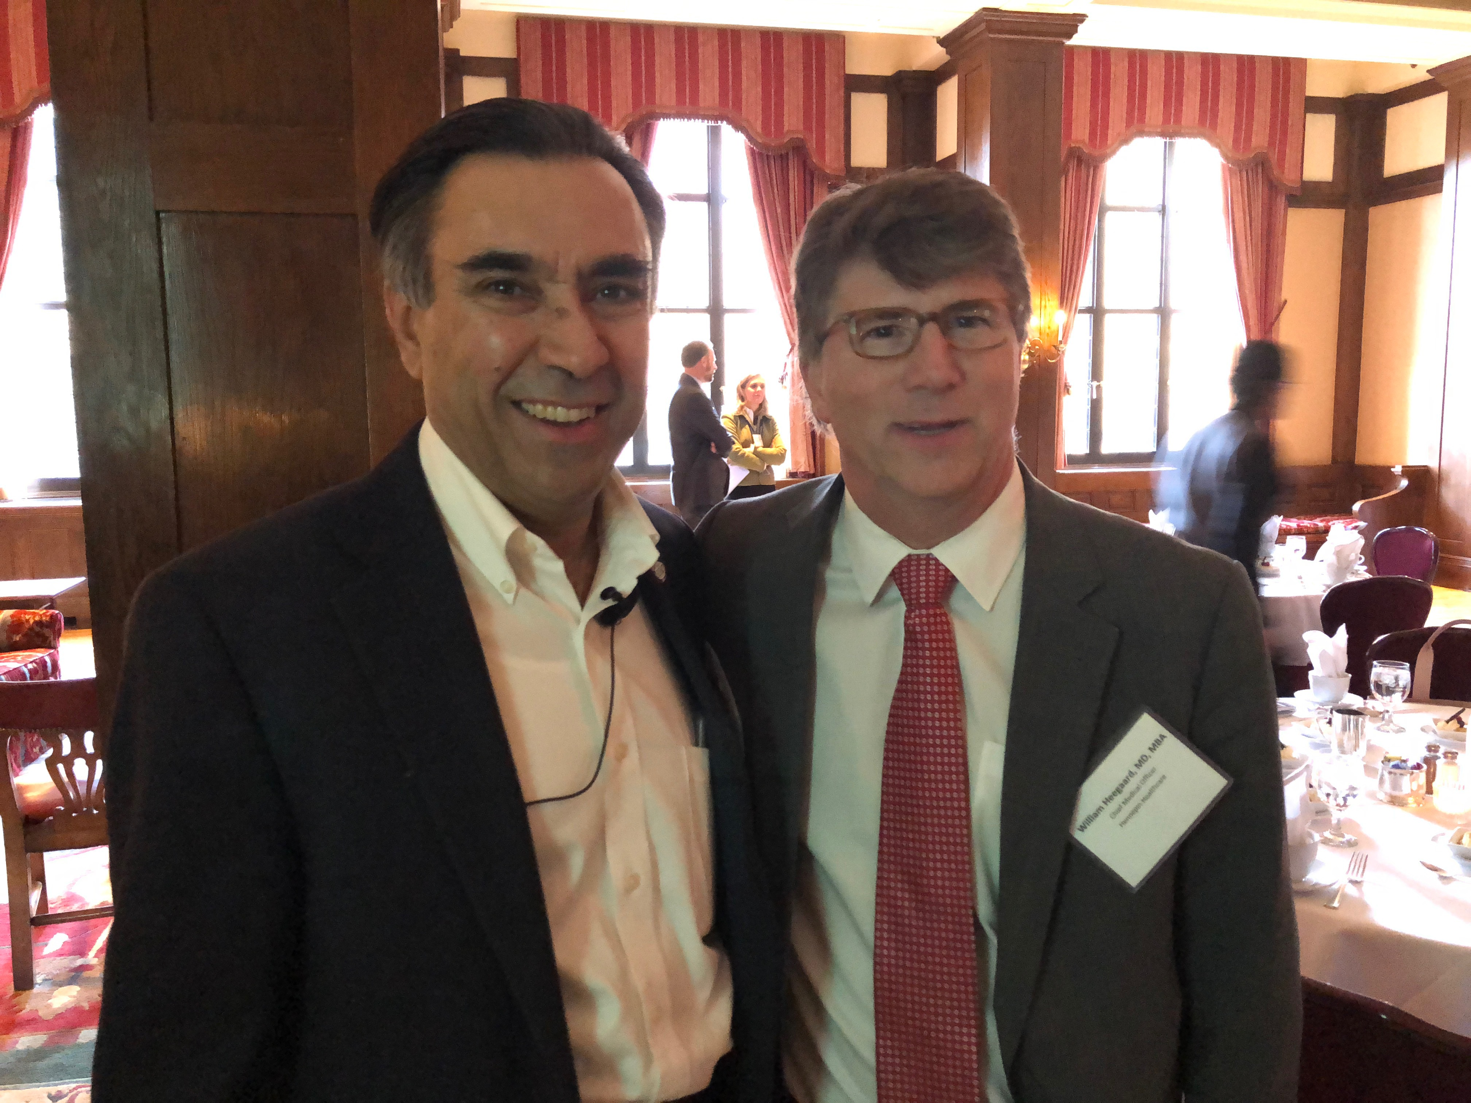
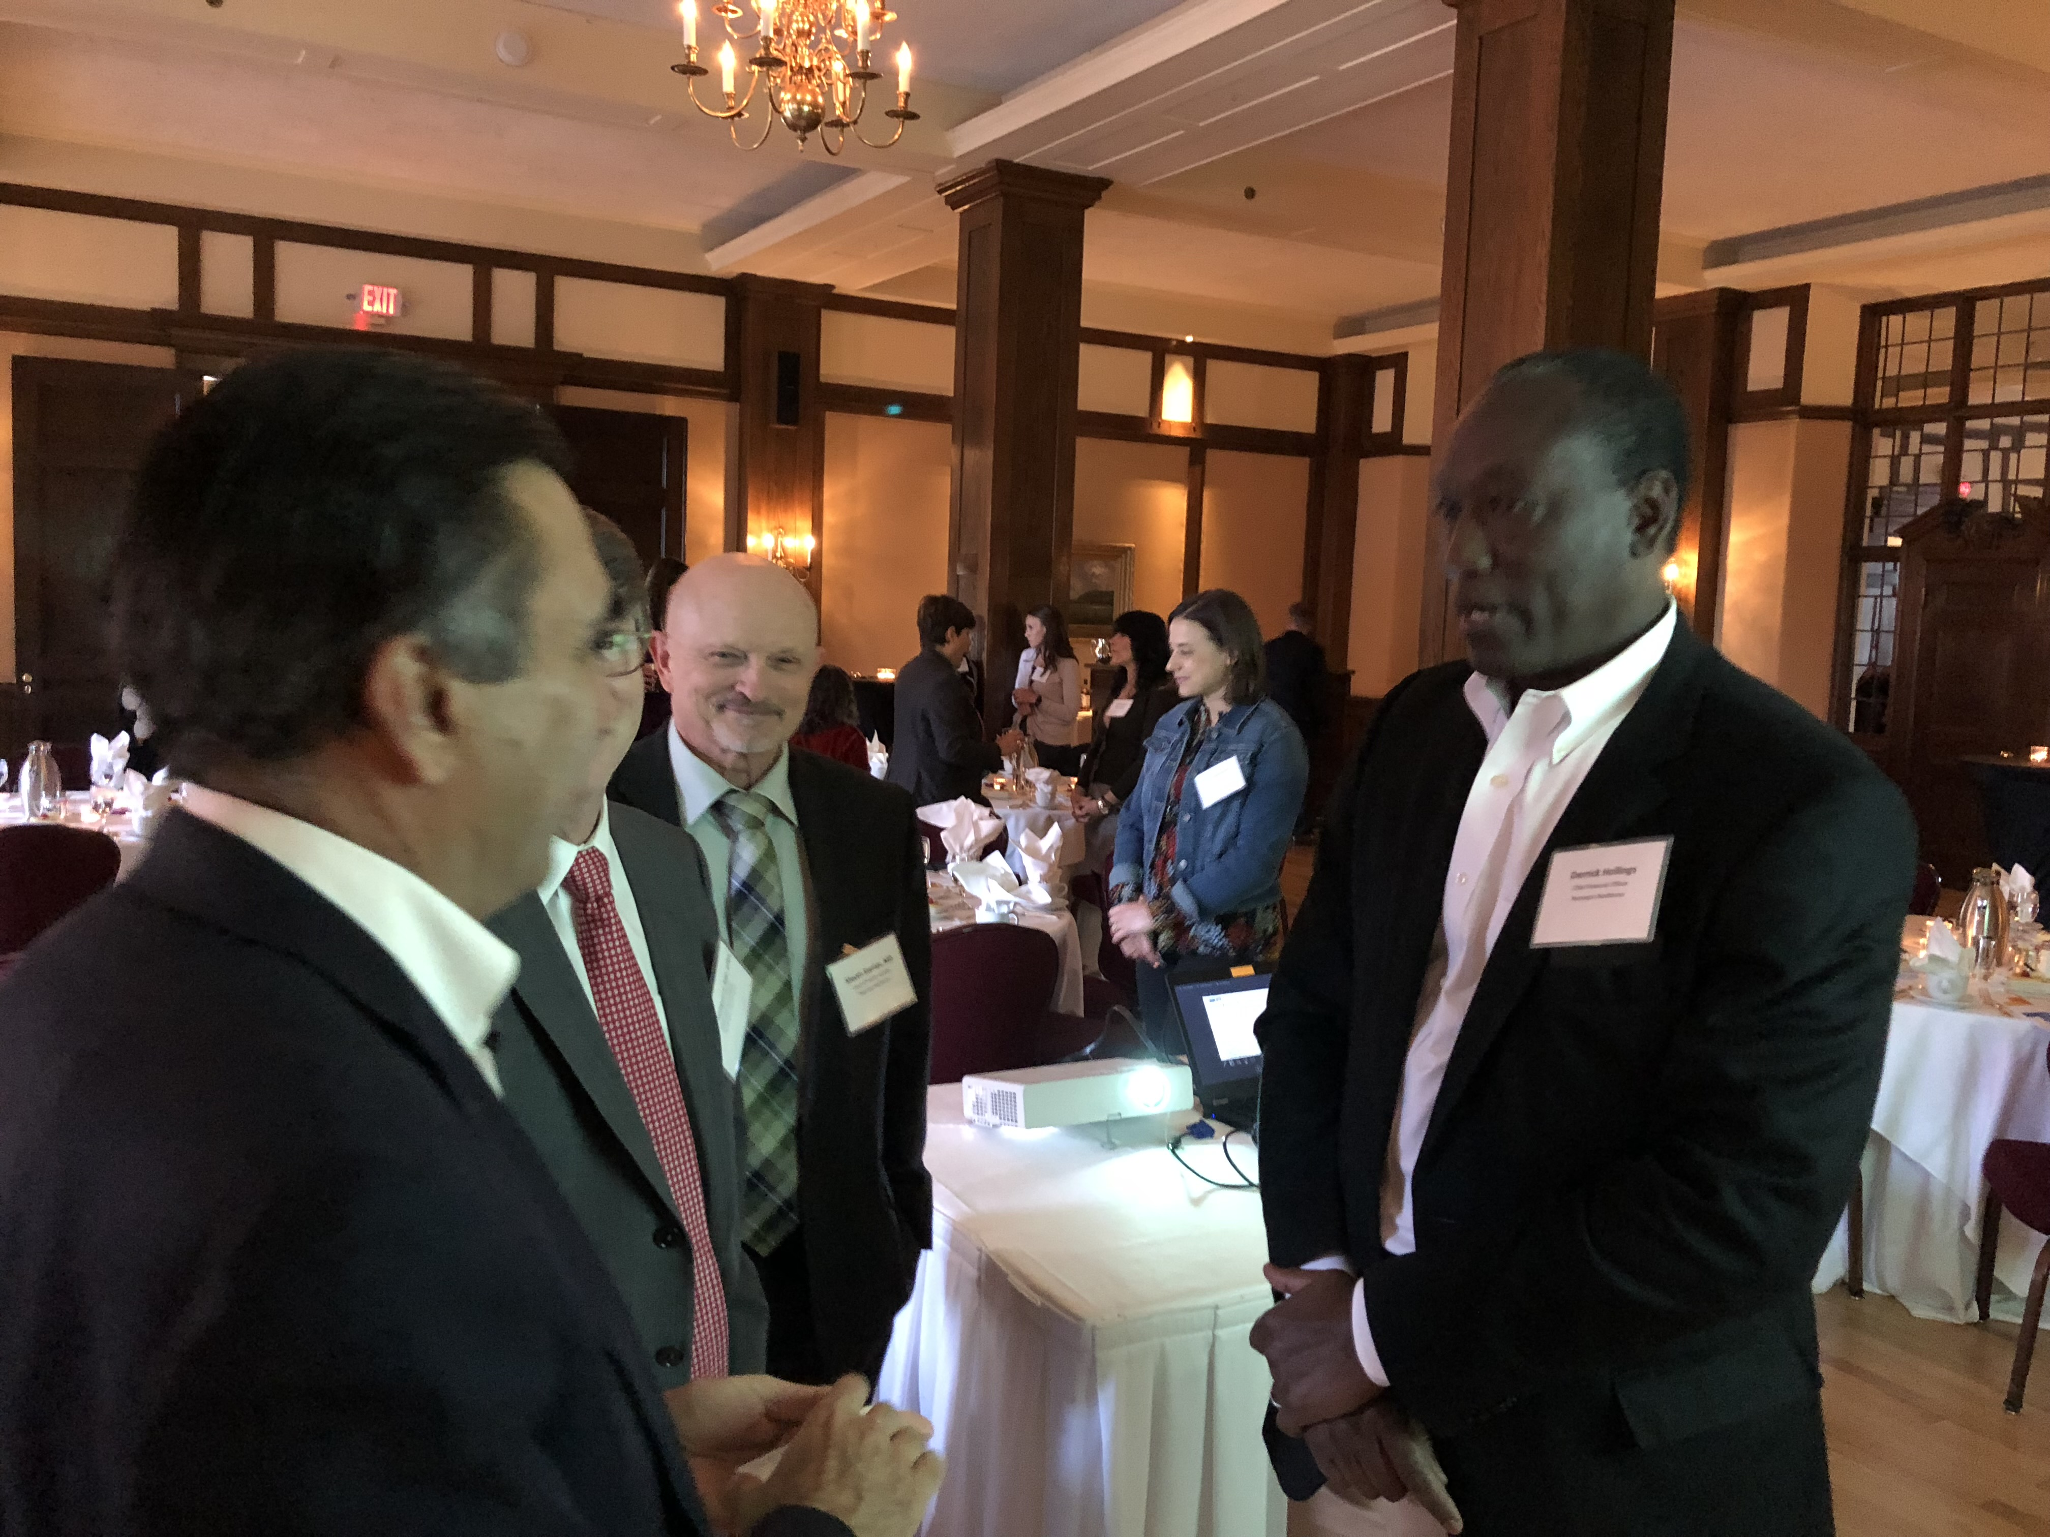
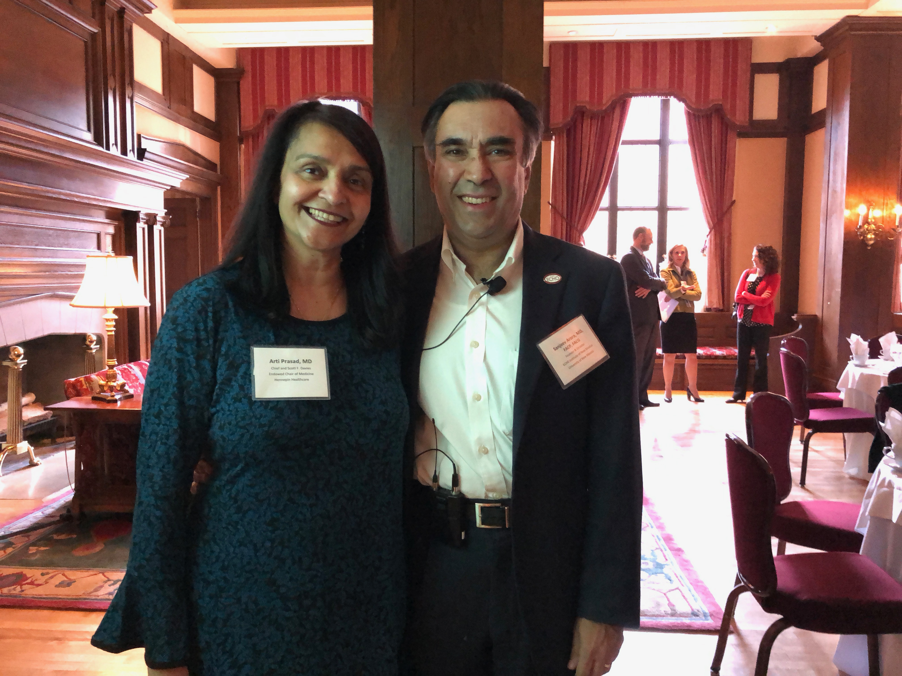
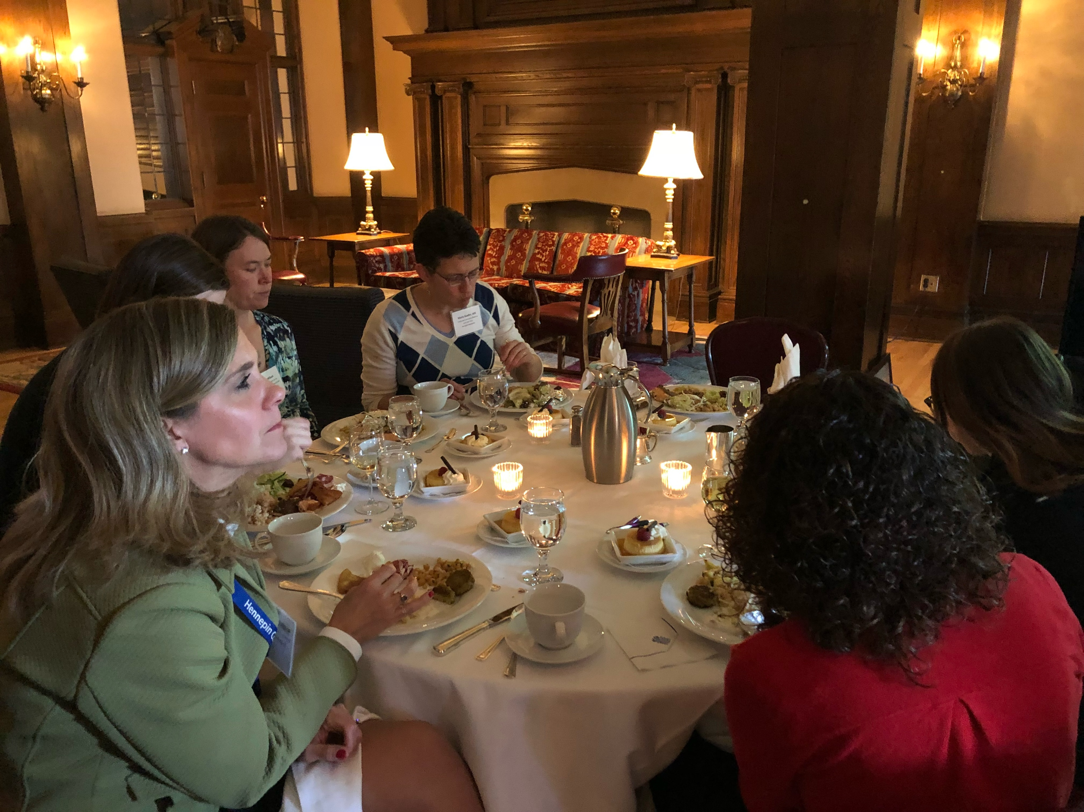
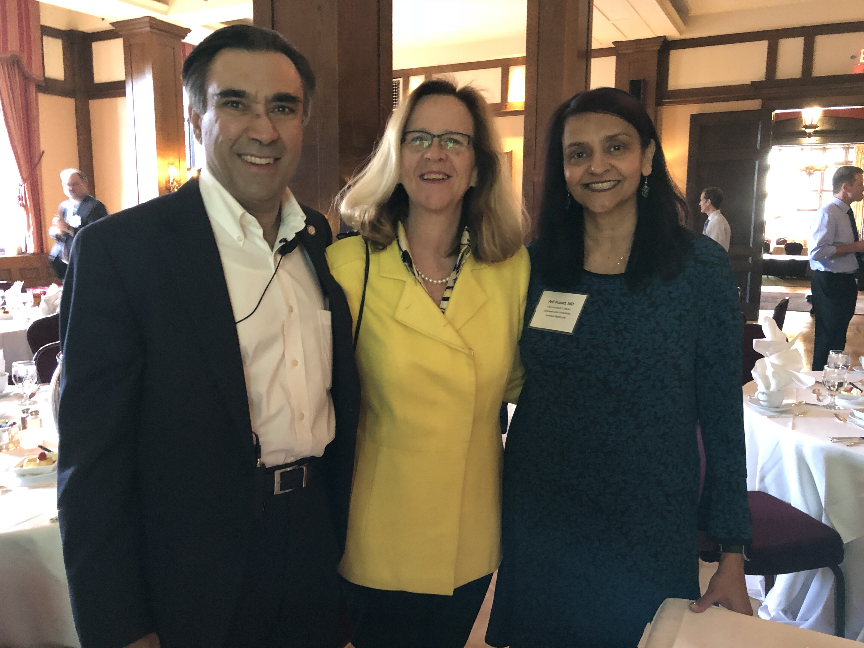
April 25th, 2018, Minneapolis Club

Slide 20
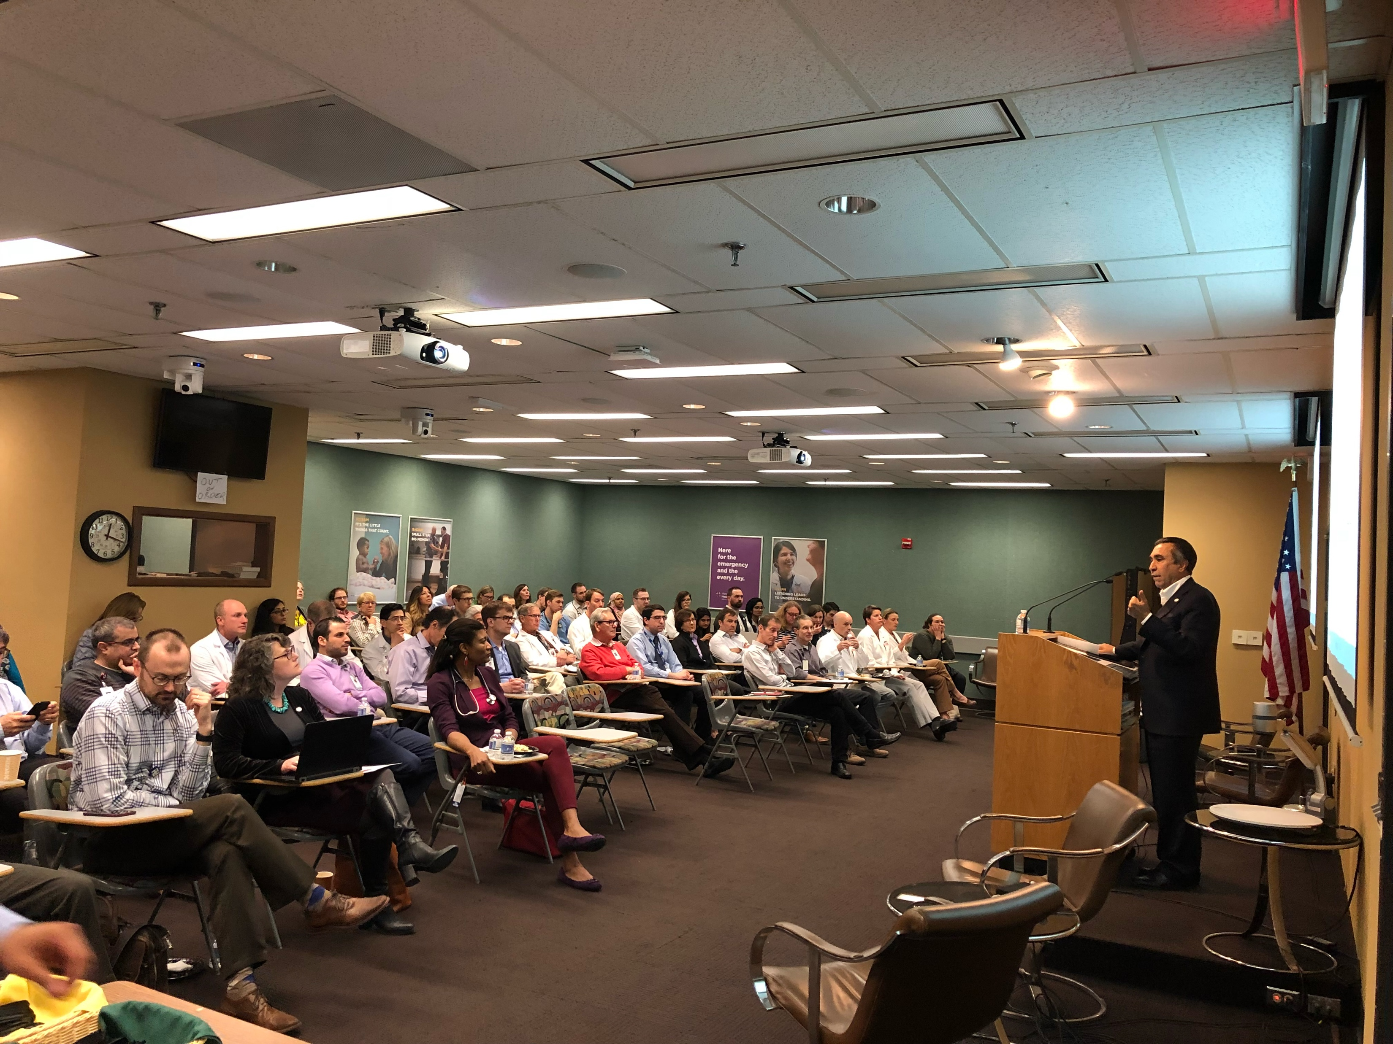
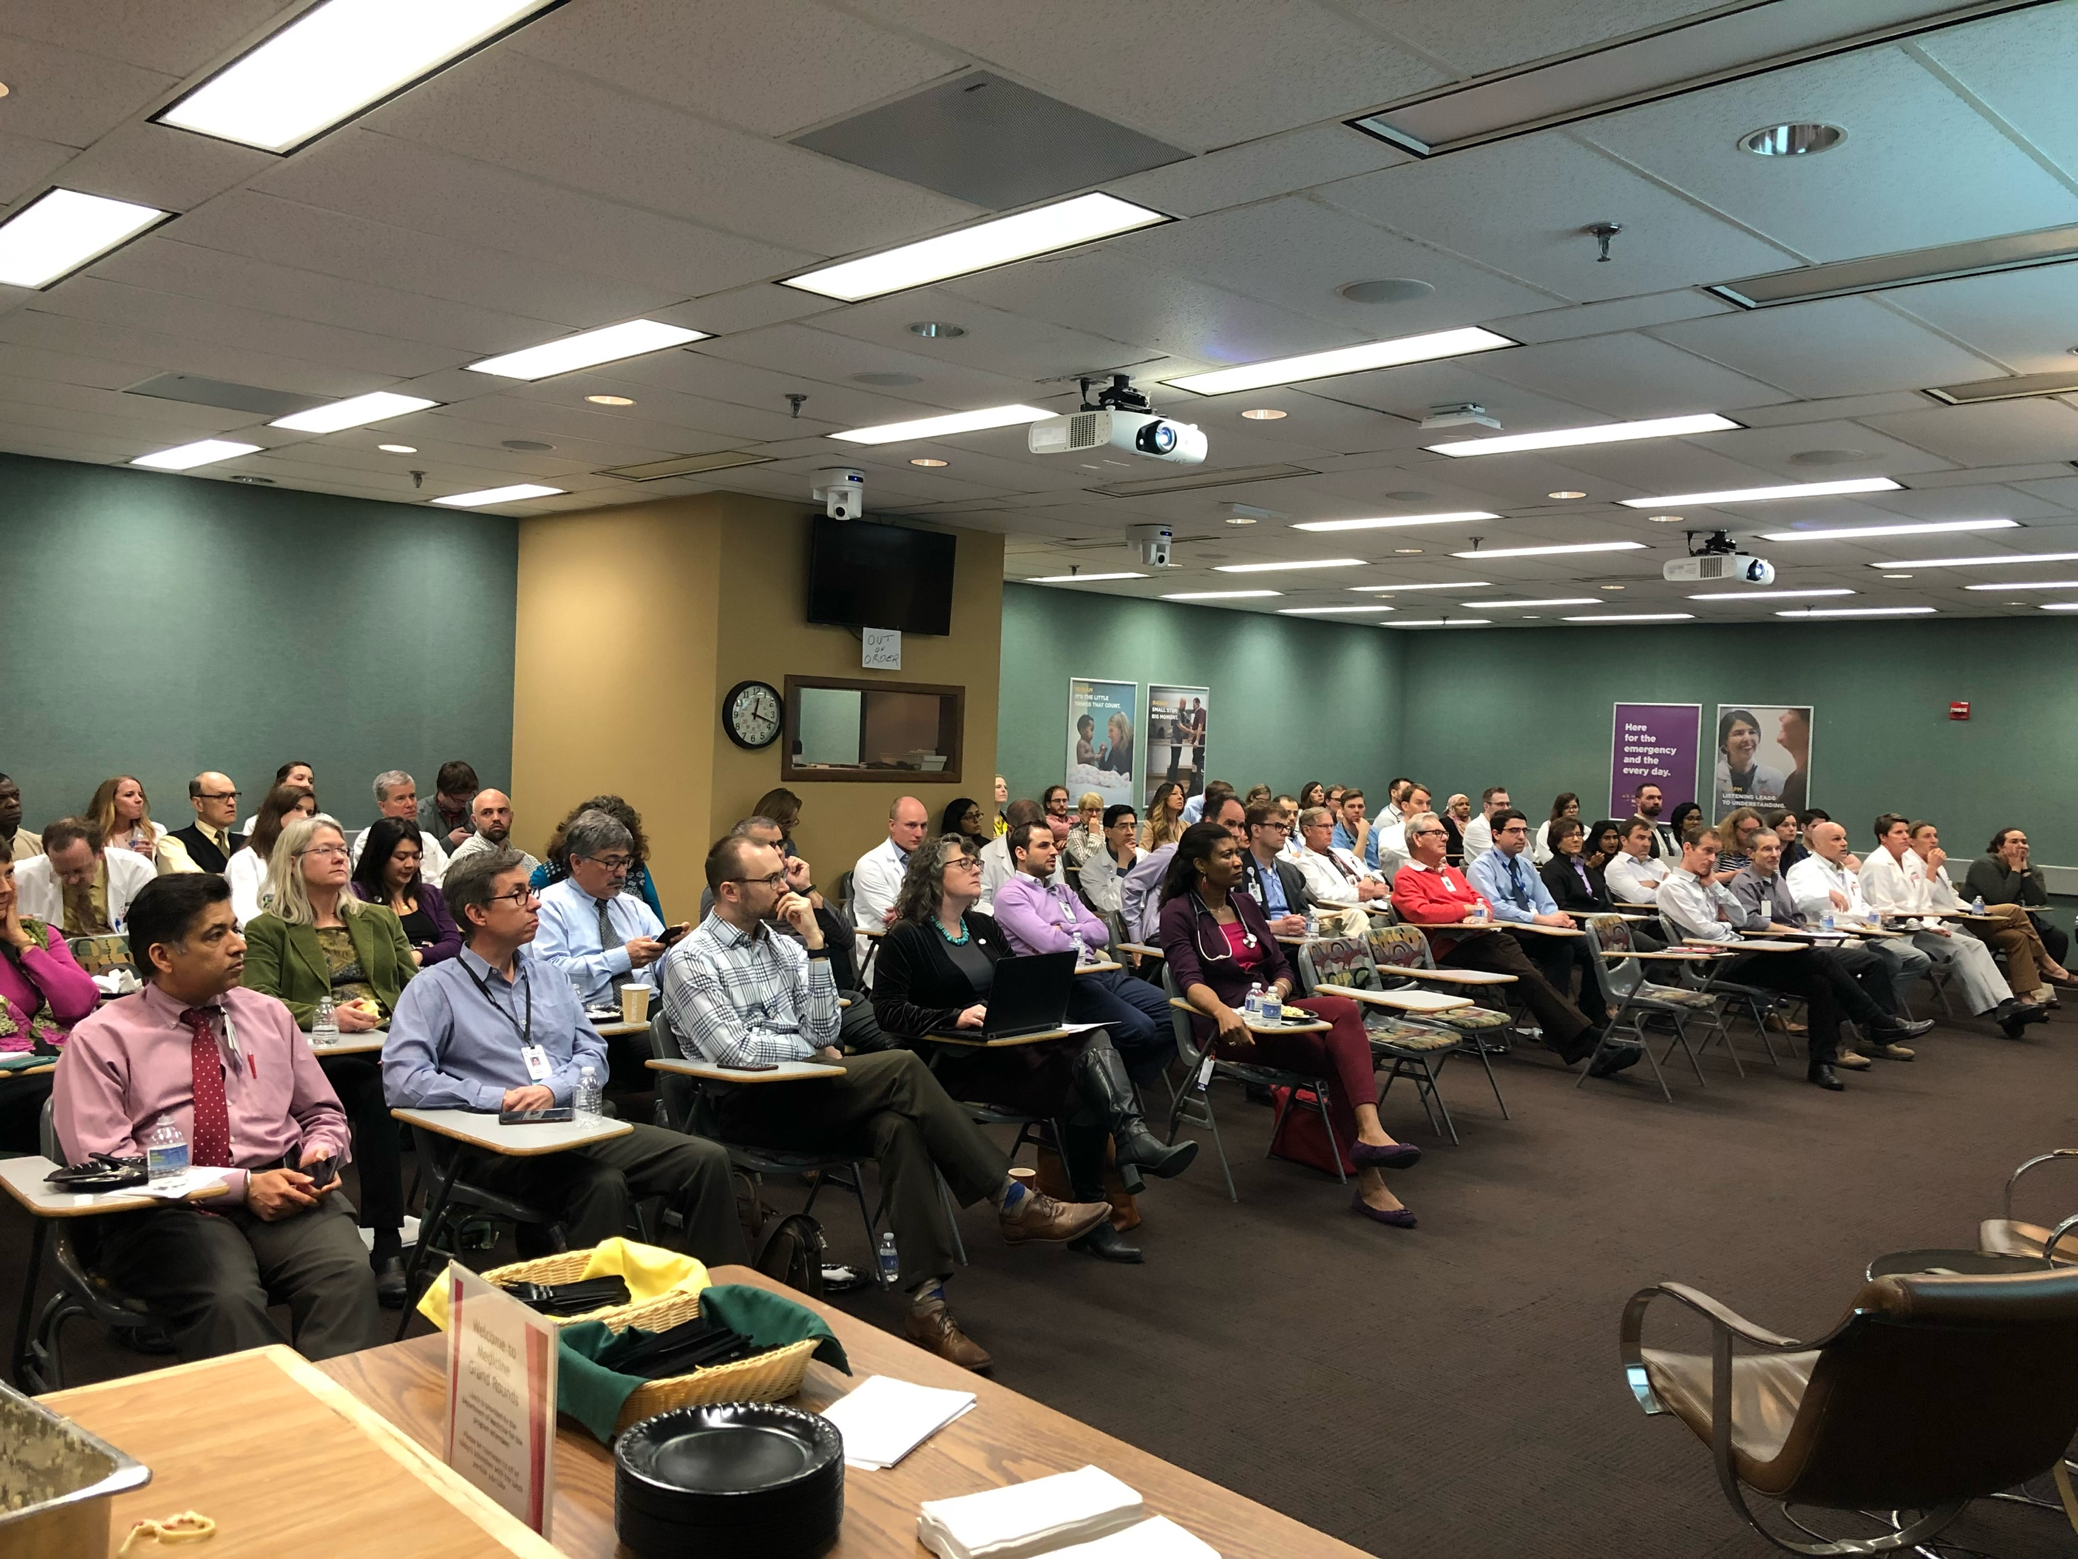
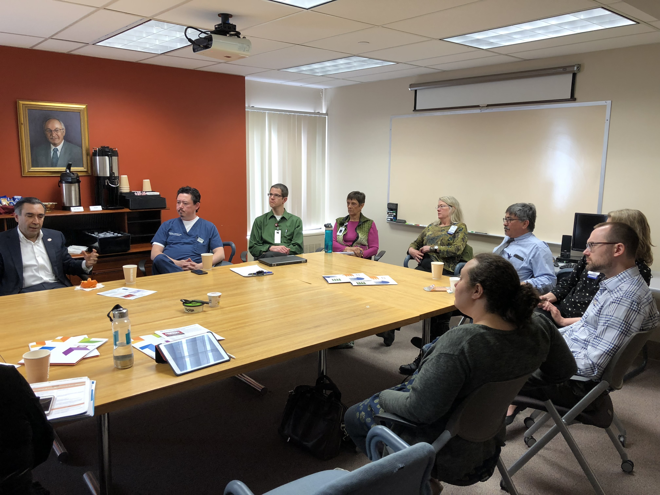
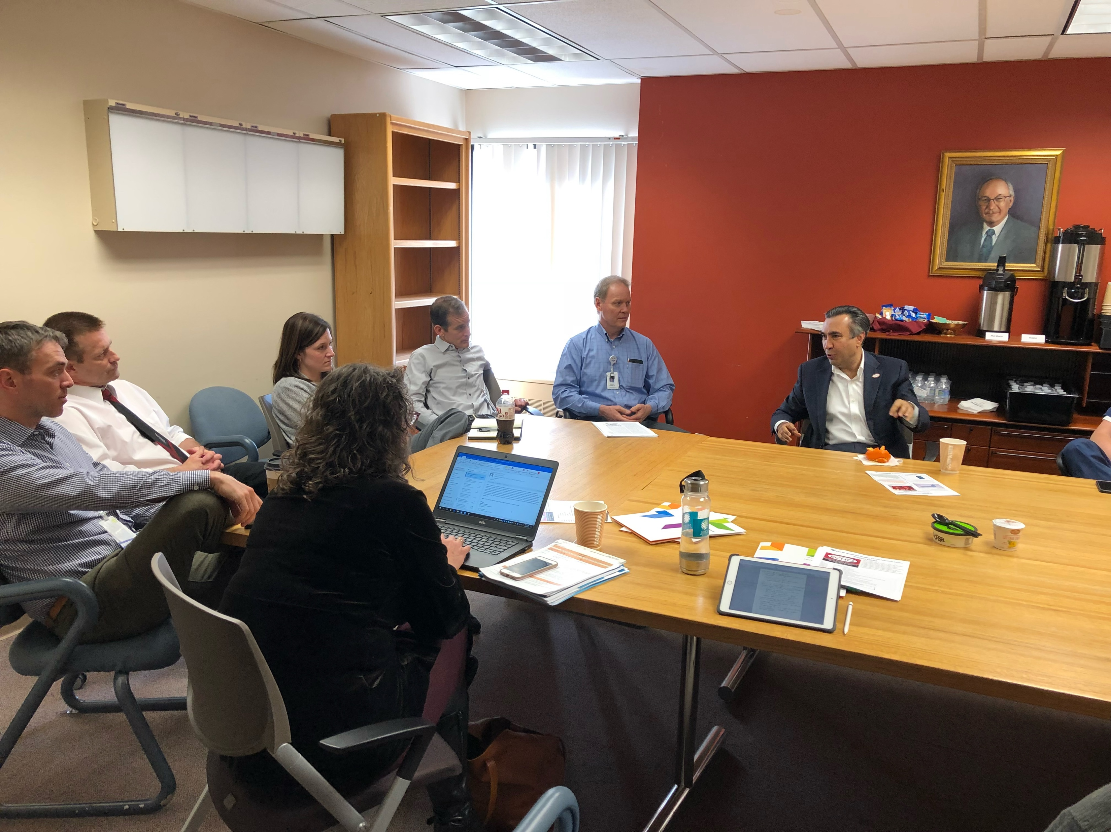
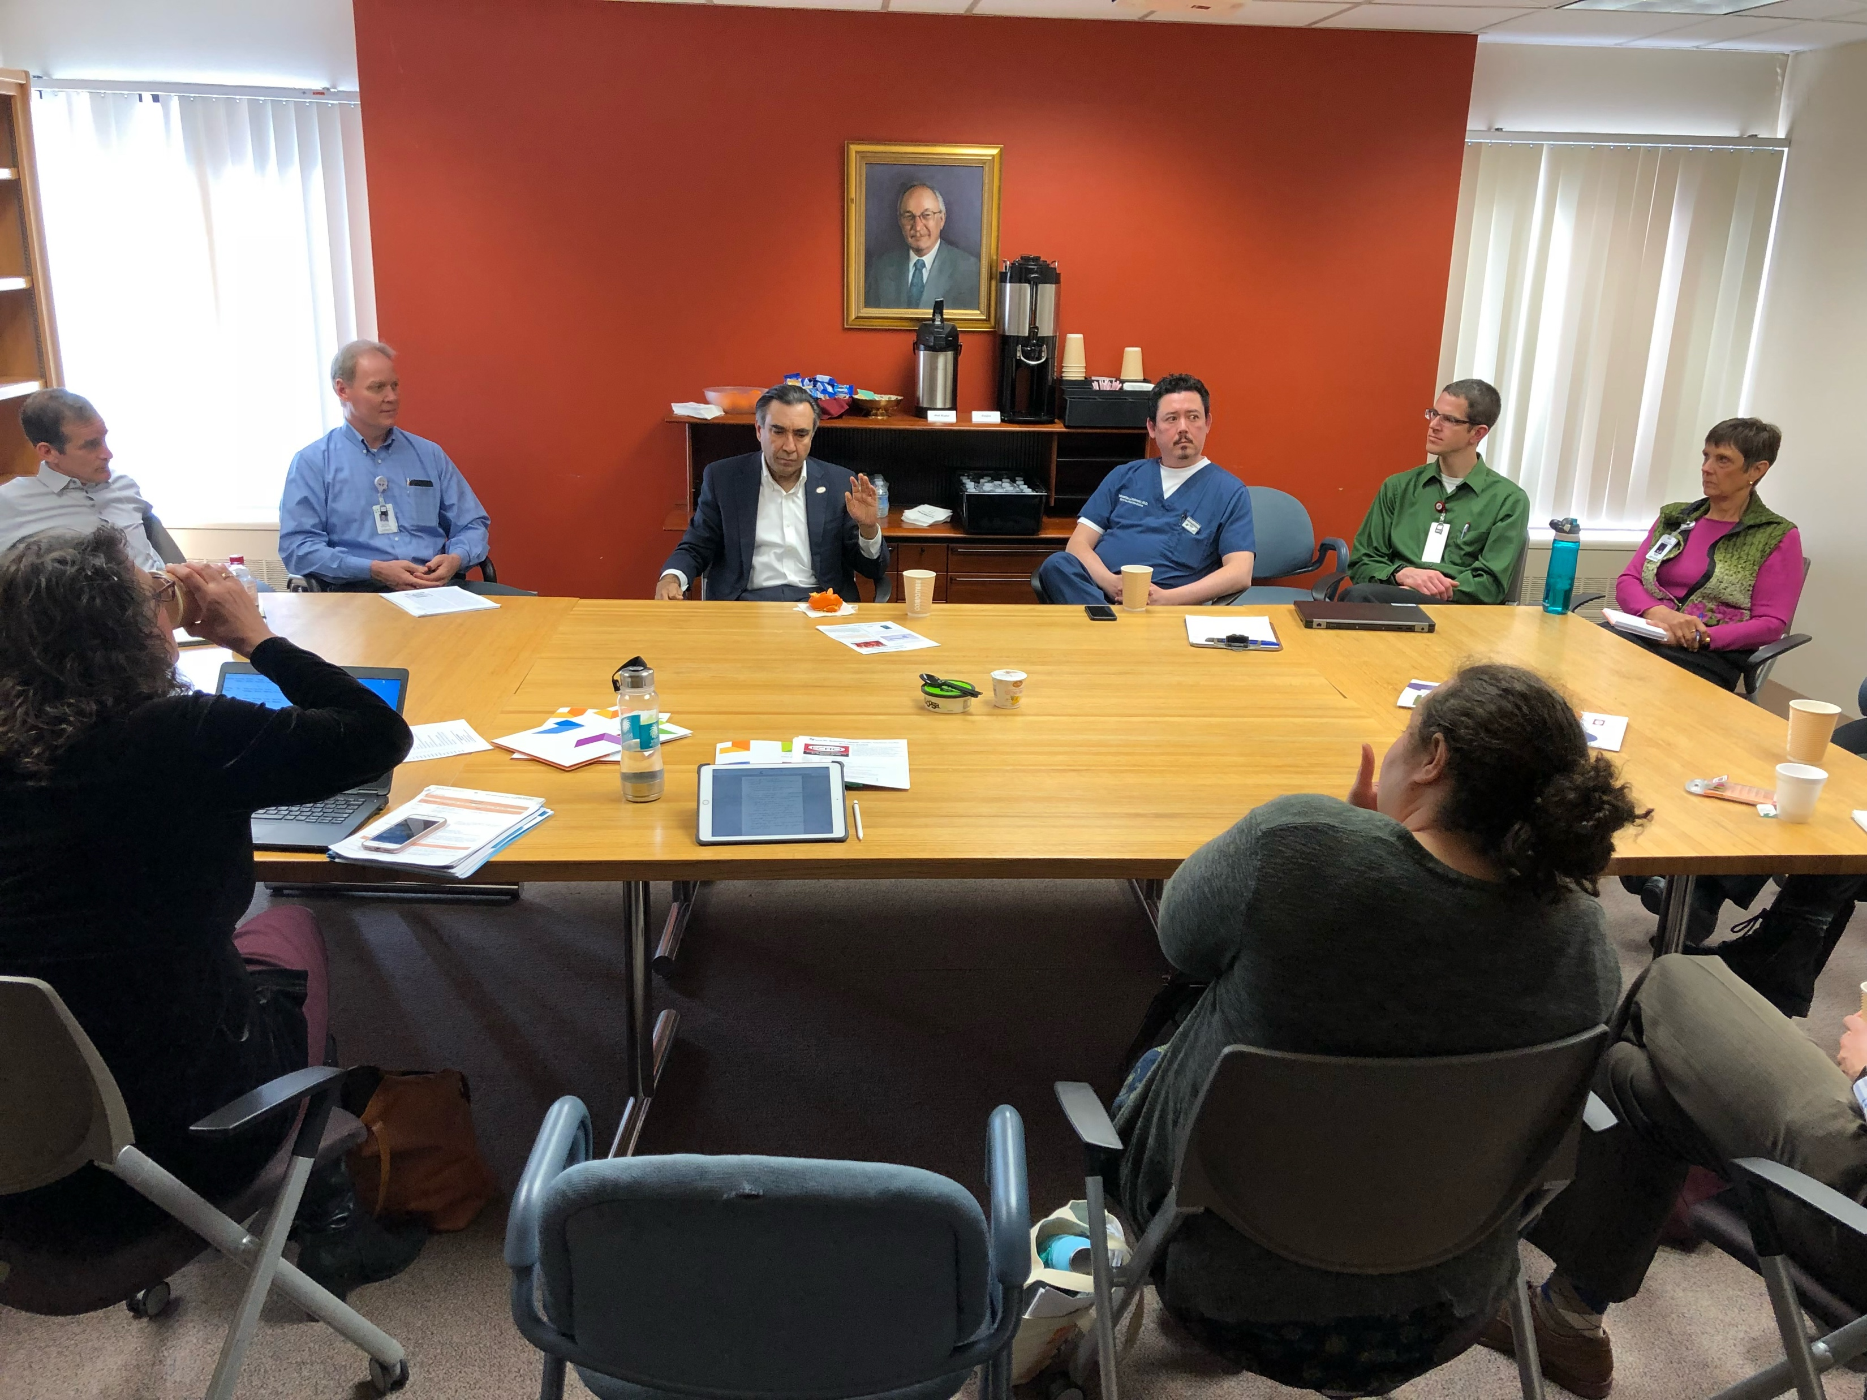
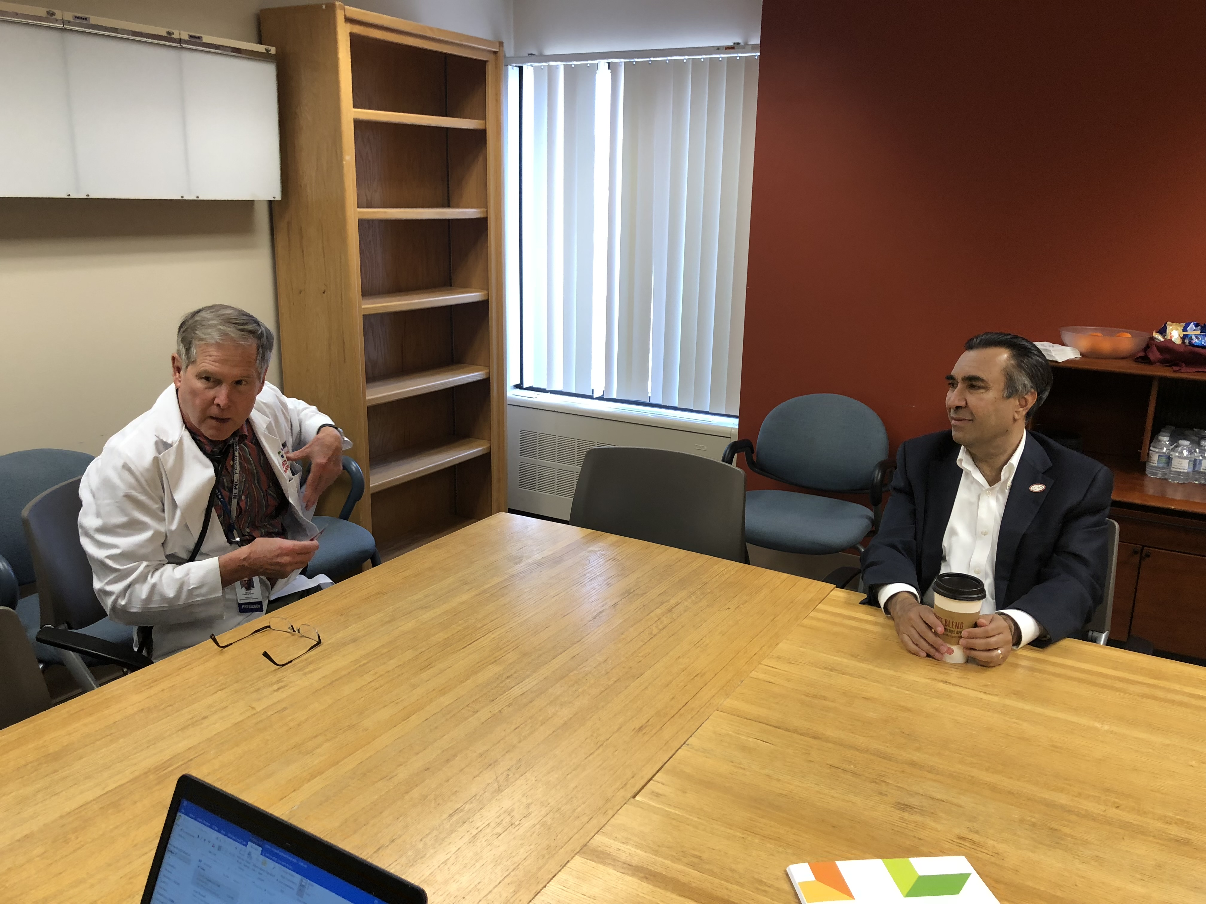
Dr. Sanjeev Arora, Alwin Schultz Scholar Visiting Faculty, HHS, April 26th, 2018

Slide 21
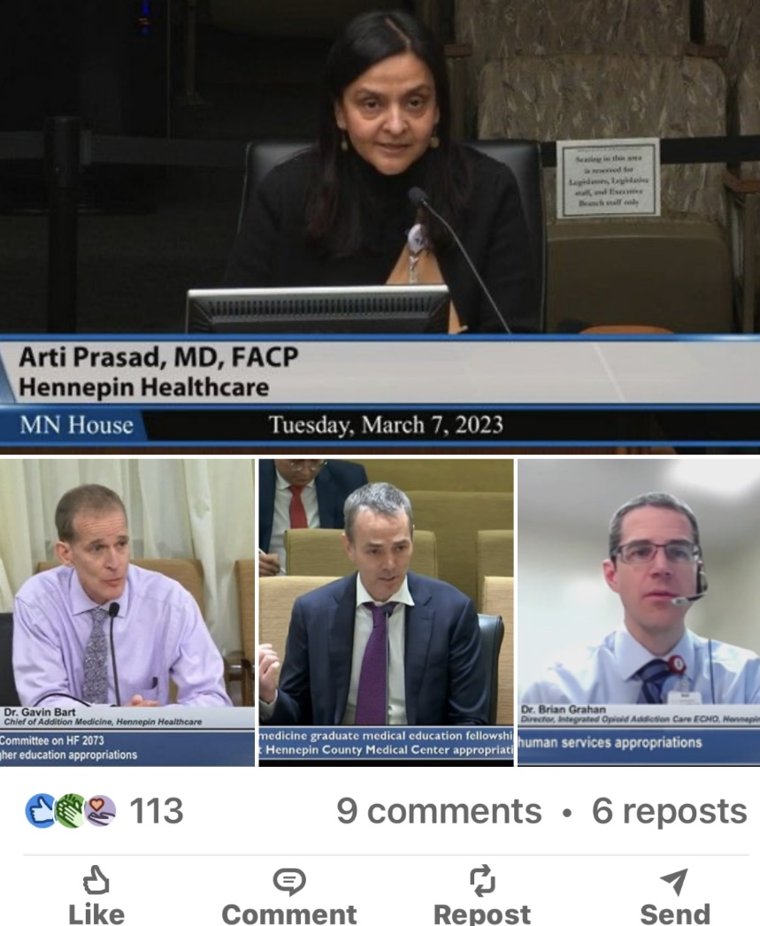
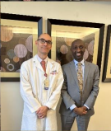
Advocacy for Project ECHO
Notes:
Dr Prasad

Slide 22


ECHO MN
(HHS-Arti Prasad)
MN Community Collaborative on Viral Hepatitis
(Jesse Powell)
MN Geriatrics
(UMN, HCMC – Emily Escue)
Integrated Opioid and Addiction Care
(Brian Grahan)
Integrative Pain Care
(Susan Haddow, Kate Shafto, & Catherine Justice)
Peer Recovery Support Training
(Cole Pueringer, Catherine Justice, DPT, & Caddy Frink)
Community Health Worker Training
(Cole Pueringer, Catherine Justice, DPT, & Angela Fields)
Perinatal Substance Use
(Lauren Graber, Cresta Jones)
Communicate Care Fellowship for Eliminating Racism in Substance Use ECHO
(Cuong Pham, Cedric Weatherspoon)
Trauma-Informed Care
& Health Equity
(Mitch Radin, Tegan Carr,
& Catherine Justice)
Upper Midwest Nursing Home COVID-19
(HCMC, UMN)
NEW BRANDING - ECHO MINNESOTA (2023 - present)
Notes:
Dr Prasad

Slide 23

History of Project ECHO at Hennepin Healthcare (2018 - 2026)
Addiction ECHO
Integrated Opioid and Addiction Care ECHO
MN Community Collaboration on Viral Hepatitis ECHO
MidWest Tribal ECHO
MidWest Tribal ECHO
Nursing Home COVID-19 ECHO
MN Geriatrics ECHO
Perinatal SU
Perinatal SU 2.0
Perinatal SU Workforce Development Grant
Racism SU
Racism SU 2.0
Integrated Pain Care
Trauma-Informed Care
Peer Recovery
CHW ECHO
2018
2019
2020
2021
2022
2023
2024
2025
2026
Notes:
Dr Prasad

Slide 24
Steps for Replication (ECHO Fidelity)
Orientation is just the beginning…
Next you sign partnership documents
Begin planning budget and seek funding
Design the project (target audience, curriculum, resources, community needs, evaluation strategy and tools …)
Develop your team – experts and staff
Bring a team for full training (3 days – Immersion)
Continue to develop curriculum, begin to recruit spokes/participants
Build organizational buy-in
Practice before you launch – get feedback
Launch!
Continue to seek input and reflection, constant QI
Publicize your success – money follows successful ECHOs (not the other way around)
Copyright 2017 Project ECHO®, used with permission
Notes:
Dr Prasad

Slide 25
Partnership Documents: Guiding Principles
Collaboration with ECHO requires:
  Replication Statement of Collaboration – Front-end document that outlines the roles and responsibilities of both partners in any replication collaboration.
  IP Terms of Use Contract – Legally binding agreement that details all the elements of the Statement of Collaboration, with a specific focus on Intellectual Property issues.
What do you agree to?
  Following the ECHO mission and model
  Using the ECHO name and trademarks
  Mutual expectation of sharing
  Using iECHO
  Not selling ECHO IP to outside 3rd parties
  Non-exclusivity
Copyright 2017 Project ECHO®
Notes:
Dr Prasad

Slide 26
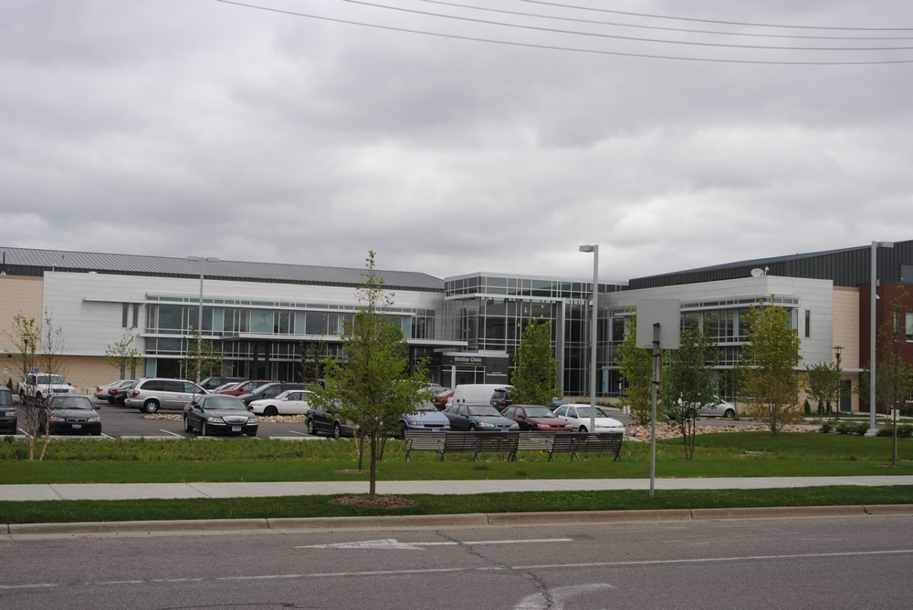
Case – Sue Haddow
My context:
Family doc, urban underserved population, residency training program.
Provide integrative primary care.
3 other IH providers in our clinic.
We all have closed practices! Our colleagues often ask us questions about various aspects of IH.
How can I help spread info without having everyone do a fellowship?
Notes:
Sue

Slide 27
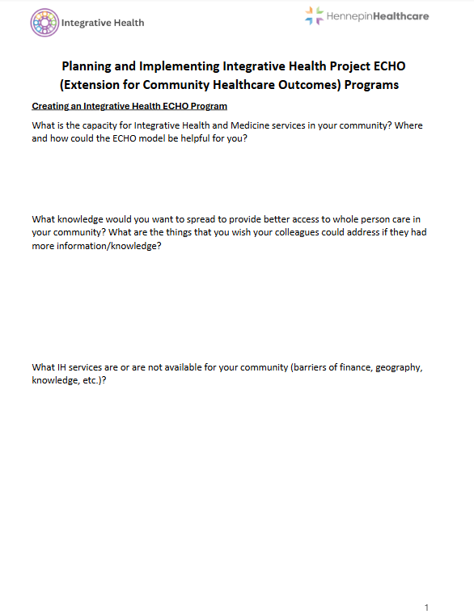
Workshop Breakout
In your groups, use the worksheet to discuss and make notes on the following:
What is the Integrative Health capacity in your community?
Where and how could the ECHO model be helpful for you?
If you could wave a wand and spread knowledge – what knowledge would you want to spread?
What are the things that your colleagues could address if they had more information/knowledge?
What IH services are or are not available for your community (barriers of finance, geography, knowledge, etc.)?
Notes:
Kate

Slide 28

Choosing an ECHO Topic
  Three Criteria:
    High Disease Burden
    High Cost
    Low Access
Notes:
Cat
Sample Topics:
DM
CA
Weight Management
CVD
Stress Management
Nutrition
etc.

Slide 29
ECHO Secrets of Success: Pick the Right Topic
Community needs/gaps in care
Availability/interest of hub team members
Fits the interests of community providers/spoke champions
More or less protocol-driven?
External motivators: chronic pain, HCV, rheumatology, HIV
Some diseases/topics find more traction
Not too broad, not too narrow
Copyright 2017 Project ECHO® used with permission
Notes:
Cat

Slide 30

Case: "I'm the only one in the system..."
Context: New Integrative Pain Care (IPC) consults in Interventional Pain Clinic
Problem: many referrals, quickly exceeded capacity, frequent in-box messages from colleagues asking about supplements, diet, etc.
Response:
Started I-GMV program (MDH funding)
Resident and faculty IPC education (informal and formal)
Recognition that there was more education needed on IPC
Notes:
kate

Slide 31
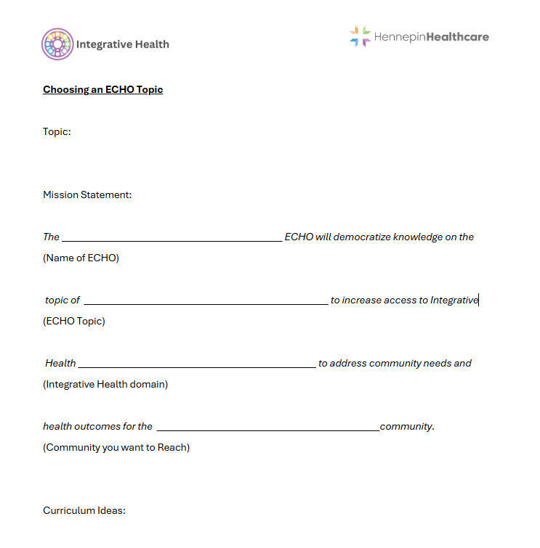
  Workshop Breakout: ECHO Topics
Pick a topic
Mission Statement
Sample Curriculum*
*teach and translate IH materials to non-IH colleagues
Notes:
Cat

Slide 32
Planning and Implementing your IH ECHO
  Funding
  Collaborative Team
    Importance of ECHO Coordinator
    Hub Director
    Co-Leads
    SME’s
    Spokes
    Stakeholders - who will be impacted by and/or support the program?
  Outreach and Marketing
Notes:
SUE (Dr Prasad to talk on Funding)
Check on PEARL for a sample budget
Direct Benefits:
Visibility
Training opportunities for your staff and larger community
Making a difference in community health outcomes
Provider satisfaction
Connection and collaboration across diverse professions
Spokes - improves confidence and decreases stress/burnout
CME
Easy to access teachings
Indirect Benefits:
Disease burden reduction across a larger geographic region
Keeping healthcare funds and delivery local - cost savings across the system
Improved access across wider geographic areas

Slide 33

Case
  Trauma Informed Care and Health Equity ECHO
    Mission
    Diverse Team
    Format
    Curriculum
Notes:
Cat
History:
2020 – Hospital board made a commitment to improve HE with TIC principles – unique situation with George Floyd's murder
Mission:
The Trauma Informed Care and Health Equity ECHO will explore trauma and its impact within patients and healthcare workers as well as the context each of them brings to the healthcare encounter and the larger context of the healthcare system and larger society. Through ECHO sessions, we will broaden and deepen understanding of trauma for improved healthcare outcomes, improved delivery of healthcare, provider/healthcare worker wellbeing. We recognize that trauma is bigger than just a patient experience - it lives within providers/healthcare workers and within our histories and systems. Through appreciating the complexity of trauma and the interrelated factors that influence experiences of trauma and trauma recovery, we aim to take an active role in transforming our healthcare system to promote safety and healing and deconstruct systemic barriers to wellbeing for everyone.
Leadership Team:
MDs, PT, Psychology, HE Program Director – Community violence prevention, chaplain, community activist
SMEs: yoga/meditation/community activist, MD, chiropractor, invited speakers (primary care, DEI programming, etc)
Format / Curriculum:
TIC ECHO is more about how we process trauma internally ourselves, through our bodies, personal experience.
Format: we are our own cases, asking participants to delve into deep self-inquiry to better understand how TIC and HE can be better realized in their body, life, and work

Slide 34
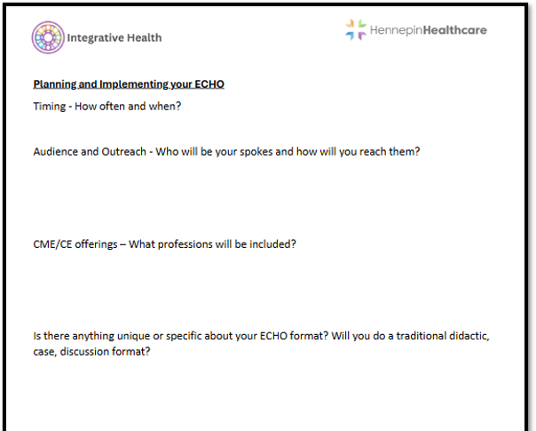
  Workshop Breakout: ECHO Planning
Timing
Spokes
ECHO format
CME/CE
Notes:
Sue
ECHO Format: – didactic and discussion balance
Timing - How often and when?
Spokes - Who will you reach out to?
CME/CE offerings – what professions?

Slide 35
Key Ingredients for a successful ECHO
Attendance
Geographical reach
Engagement of spokes
ECHO team experience
Research outcomes
Notes:
Kate

Slide 36
Impact and Evaluation
All teach, All learn
Team derief, review feedback, adapt process
Dry run w/ presenters, preview of cases
Shared responsibility for engaging participants
KSA (Knowledge, Skills, Attitudes) survey – developed by team; offered after each session
Notes:
Kate
We're in process! Share stories about team process and evolution, debriefing, adapting our process over time w/ feedback from ECHO; doing a “dry-run” w/ presenters; how to engage participants, evaluation and feedback
What makes a successful ECHO?
Attendance
Geographical reach
Engagement of spokes
ECHO team experience
Research outcomes
Impact/evaluation - KSA development in process

Slide 37


  Workshop Breakout: ECHO Vision
  Write a Vision Statement: if your ECHO was successful, what world would we see?
Notes:
Cat

Slide 38
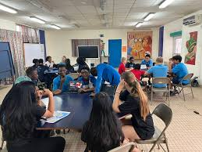
Celebrate Success!
  Small Group Presentations
Notes:
Cat

Slide 39

You just attended a Project ECHO session!
Notes:
Dr Prasad

Slide 40
We are grateful for many things!
State legislature’s generous funding
Department of Human Services (DHS)
Hennepin Healthcare Foundation
Our spokes/learning communities
Our MN wide community of residents and patients
Our internal and external ECHO team members
Notes:
Dr Prasad

Slide 41


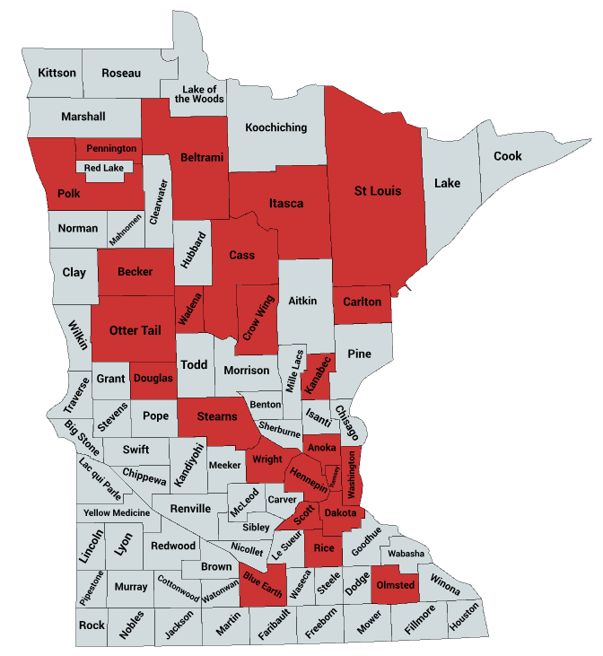
MINNESOTA
The 24 counties reached by Project ECHO Minnesota in 2024.
Notes:
Dr Prasad

Slide 42


catherine.justice@hcmed.org
arti.prasad@hcmed.org
susan.haddow@hcmed.org
  kate.shafto@hcmed.org
Notes:
Dr Prasad

Slide 43
The 24 counties reached by HHS Project ECHO Minnesota in 2024.
The map includes the following ECHO programs: Integrative Pain Care (IPC), Trauma-Informed Care & Health Equity (TIC&HE), Perinatal Substance Use (PSU), Minnesota Community Collaboration on Viral Hepatitis, and Integrated Opioid and Addiction Care (IOaAC) from January 1st – December 31st, 2024

Slide 44
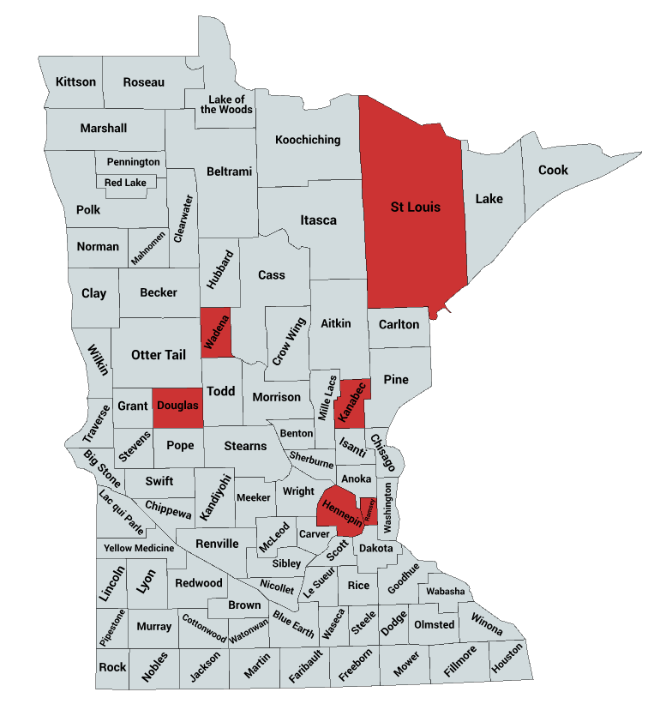
Integrative Pain Care (IPC) ECHO
Breakdown of IPC Attendees by County for 2024:
Douglas County: 1 attendee
Hennepin County: 50 attendees
Kanabec County: 1 attendee
Ramsey County: 3 attendees
St. Louis County: 2 attendees
Wadena County: 2 attendees
SOURCE: All teach, all learn. iECHO. (n.d.). https://iecho.org/home

Slide 45
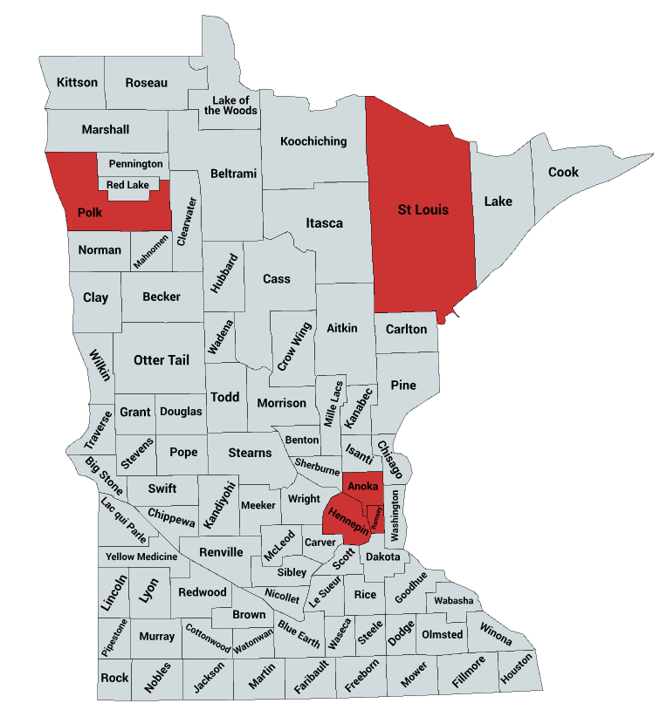
Trauma-Informed Care and Health Equity (TIC) ECHO
Breakdown of TIC Attendees by County for 2024:
Anoka County: 4 attendees
Hennepin County: 64 attendees
Polk County: 1 attendee
Ramsey County: 4 attendees
St. Louis County: 2 attendees
SOURCE: All teach, all learn. iECHO. (n.d.). https://iecho.org/home

Slide 46
Lessons learned at Project ECHO
Problems
Not following the ECHO Model
Presuming ECHO is just curbside consultation instead of educational capacity building
Presuming ECHO is easy
Assuming superiority over primary care or generalists
Assuming that collegiality occurs without effort
Being inaccessible to partners
Not optimizing videoconferencing connectivity, or user support
Not engaging interdisciplinary team
Successful replications
Face to face relationships are crucial before technology is introduced
Get technical assistance from experienced ECHO clinicians
Careful planning for the desired outcomes
Don’t depend on philanthropy: look for third-party (insurance) payers and government revenue sources.
Copyright 2017 Project ECHO®
Notes:
Dr Prasad

Slide 47
ECHO Secrets of Success:
Pick the Right Champions/Facilitators
Transformational Learning REQUIRES Transformational Leadership: choose your mentors and SME’s carefully
Get good help and Train them well!
Copyright 2017 Project ECHO®
Notes:
Kate

Slide 48
ECHO Secrets of Success:
Always focus on the needs of your learners/participants
The objective of the ECHO model is to create workforce multiplication and capacity building, with all team members working at the top of their game and the height of their scope of practice.
Copyright 2017 Project ECHO®
Notes:
Dr Prasad/Kate

Slide 49
ECHO creates value for Patients
Less travel, saves money
Less travel, less impact on family and work life
If undocumented, may avoid interception on US highways (back roads always take much longer)
Patient gets care from a provider they know and trust
More direct route to “right care, right place, right time” creates improved outcomes, improved quality of life, reduced pain and anxiety, reduced downstream complications
Few visits to specialists saves co-pay and insurance fees
Copyright 2017 Project ECHO®

Slide 50
ECHO creates value for the Community
Healthcare dollars spend in the community, not elsewhere
Reduced impact on workforce, days missed, etc.
Sense that a community is less isolated and “can take care of its own people and its own problems using its own resources.”
Ability to provide specialty care in a small town attracts businesses, doctors, etc.
Reduced turnover at clinic is a powerful stabilizing force for a community
Copyright 2017 Project ECHO®

Slide 51
ECHO creates value
for the Community Clinic
Cost: must protect the provider’s time each week for dedicated ECHO learning – this comes with reduced RVUs.
Clinic now has an in-house specialist (or a few who can refer to one another), which allows them to provide specialty care they couldn’t otherwise offer, and bill for this care.
Patients are kept local (when appropriate), avoiding the risk of being referred to other facilities (and not coming back). Patients on the rolls have financial benefits.
Patients that are more satisfied with care refer their friends to the clinic.
Patient satisfaction and Patient outcomes both improve – and these are critical metrics for hedis and other oversight agencies and systems.
Clinician satisfaction and engagement creates a happier, more productive workforce and environment.
Clinicians engaged in ongoing learning are less isolated, less likely to leave (or turnover as quickly). Clinician turnover is very expensive and destabilizing for a clinic, resulting in paying for locums tenems, recruiting fees, moving fees, training costs, etc. (often estimated at $150k or more per departing clinician).
Copyright 2017 Project ECHO®

Slide 52
ECHO creates value
for the Engaged Provider (spoke)
CME credit for free, without travel costs or inconvenience
MOC, advanced certificates and other “add-on” benefits are sometimes available
Learning is ongoing, relevant and interactive – much less boring than traditional webinars or conferences.
Intention and design is to make each participant more comfortable and more expert – not just pass on information. Feels like the process is “worth the time.”
Opportunities to engage in community-based research.
Personally engaging and fun – social network.
Professional development – new skills and opportunities can contribute to growing responsibility and job prospects.
Ability to take care of patients more effectively – better knowledge, skills and the “specialists on speed dial” for quick consult when needed.
Copyright 2017 Project ECHO®

Slide 53
ECHO creates value for the
Center of Excellence (hub)
Grant and contract opportunities with federal agencies, state agencies and organizations, international organizations, etc.
Effective triage of resources – enables delivery on current contracts, grants and other responsibilities and deliverables with greater impact and efficient use of money (sometimes money is saved).
Efficient triage of resources – specialists currently have long wait lines, and high no-show rates, lots of patients not-prepared for the visit (labs, x-rays, other prep completed and compiled) or are in the wrong line for the wrong specialist. When 60-80% of the patients are triaged safely and effectively to the community, the wait time for the remaining complex and critical patients is greatly reduced, as is the no-show rate and the number of people in the wrong line or unprepared. Specialists provide the most complex services and are able to bill more effectively.
Specialist engagement improves, as mentoring and sharing are highly energizing and rewarding for hub team members.
Publications, publicity and high-profile opportunities highlight what the university is doing for the community – good for reputation (with public and legislators).
Faculty development – ECHO creates opportunities for research, teaching and professional development across faculties. Interprofessional engagement and cross-pollination also improve.
Copyright 2017 Project ECHO®

Slide 54
ECHO creates value for the System (payers)
Reduced waste: fewer unnecessary tests, less travel (subsidized), fewer visits paid for.
Reduced hospitalization, ED visits. Increased pharmacy costs.
Improved prevention, health and outcomes for patients reduces downstream interventions: heart attacks, dialysis, amputations, blindness, cancer, disability, addiction, etc.
Higher patient function reduces Medicaid and Medicare and disability payments
Copyright 2017 Project ECHO®

Slide 55
Benefits to Rural Clinicians
No-cost CMEs and Nursing CEUs.
Professional interaction with colleagues with similar interests means less isolation with improved recruitment and retention.
A mix of work and learning.
Access to specialty consultation with GI, hepatology, psychiatry, infectious diseases, addiction specialist, pharmacist, patient educator

Slide 56
Original funding from the state for the 1st ECHO (SAMHSA?)
Dr. Gavin Bart was invited to submit a short proposal to DHS (he wrote that we would start an ECHO)
Appointed Dr. Brian Grahan as the medical lead
First ECHO coordinator hired – Roxanne Kibben
Drs. Jon Pryor, Bill Heegaard, and CFO Derrick Hollings very engaged
ECHO room was created by remodeling an existing room
Commissioner Lourey and Senator Rosen attended ECHO sessions

Slide 57
Project ECHO @HHS
2019 Funded for 1.0M over 5 years as part of the larger Opioid package that passed for Hennepin Healthcare
  $200,000/year - Expired June 30, 2024
  Ongoing grants via Opioid Epidemic Response Advisory Council and other funders
2023 New Legislation proposed to continue funding

Slide 58
Keys to success
Trust and relationship building with Rep. Noor and Rep. Baker over years
Previous exposure from 2019 – not a new idea
Legislators' first-hand experiences
State Support – DHS proposals
Letters of support from partners
Compelling testimony
Stars aligning
  Budget surplus with DFL control
  Key supporters in chair positions

Slide 59
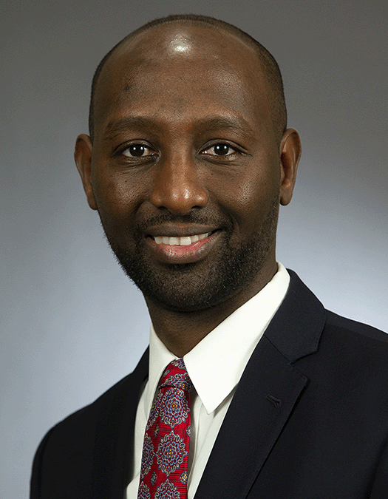

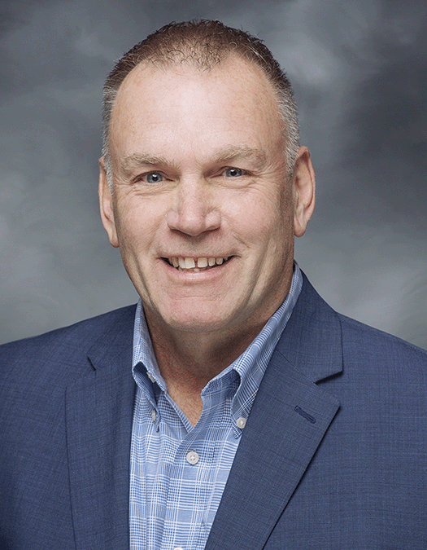

Champions
Rep. Mohamud
Noor - DFL
Chair of Human
Services
Sen. John Hoffman -DFL
Rep. Dave Baker -
Republican
Sen. Zaynab Mohamed - DFL

Slide 60
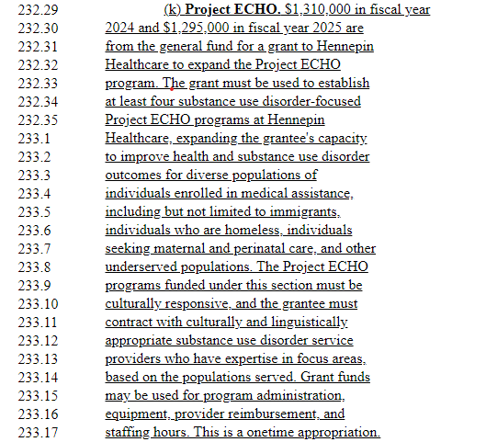
Proposed bill
language -
HF 1634
SF 2486

Slide 61
Project Echo – what passed SF2934/HF2847 Omnibus bill
1.31M in FY 2024 (begins July 1, 2023)
1.295M in FY 2025 (begins July 1, 2024)
DHS works with Hennepin Healthcare on implementation
Minimum of four Project Echos
  Focused on substance use disorders for diverse populations, Medicaid patients
  Culturally responsive and must contract with culturally and linguistically appropriate providers
  One-Time Funding for two years
$400,000 for Opioid Treatment Program - Project ECHO Quality Support –Competitive grants
Addiction Medicine Fellowship $270,000 per year

Slide 62
Director
(Arti Prasad | .3 FTE)
ECHO MN Manager (Katia Chernyshov | 1.0 FTE)
All ECHO Co-Leads
Viral Hepatitis Project Coordinator
(Diane Spielbauer |
.75 FTE)
IH ECHO Coordinator
(Esther Mwangi |
1.0 FTE)
Integrated Opioid & Addiction Care Coordinator
(Rachel Langer |
.8 FTE)
Research Consultant
(Jeff Dusek)
Research Assistant
(Jadyn Knox | .5 FTE)
ECHO-MN Leadership and Oversight at HHS

Slide 63
Additional Training Events
Addiction ECHO
March 5: ED Acute Care and Waiver Training
(Hennepin)
January 27: ED Best Practices
April 15: Waiver Training
February 19:
Boot Camp
July 23: Principles of OUD Eval and Mgmt, Olmsted Medical Center
April 20: ED Best Practices
September 9 and 16: ED Best Practices
October 20: Perinatal Waiver Training
Sept 20: ED Best Practices
October 29: Waiver Training (Essentia, St. Luke’s, Mayo)
October 14: Waiver Training
(Essentia, etc)
Joint Perinatal Summit
2024
December 5:
Boot Camp
Joint Perinatal Summit
Nov 15-16
December 13: Mayo Clinic, Kasson
2018 2019 2020 2021 2022-23 2024 and beyond

